Slide 1
Contents
Differences –train station
Telephone booth
Gas station
Foods
5. Tell what is going on in living room
Differences – office
Street scene- tell what is going on
8. Idioms

Slide 2
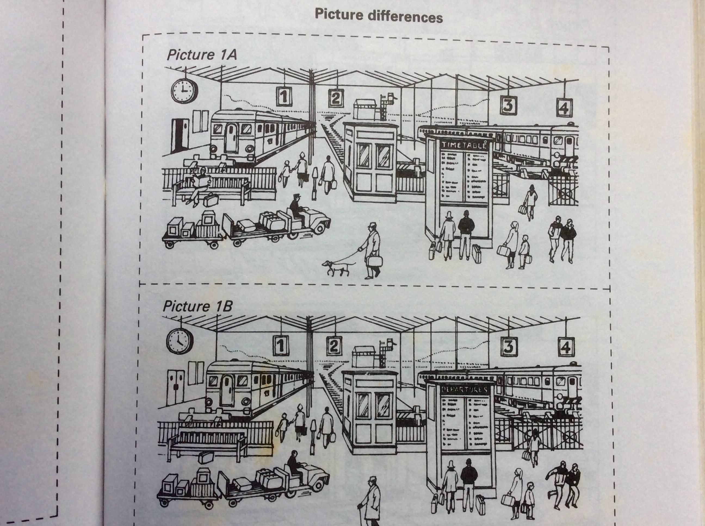

Slide 9
Idioms
break the bank
lives in an ivory tower
pulled up stakes
all walks of life
upper crust
get a rain check

Slide 10
345, 298
4, 050, 407
16, 890, 560

