Slide 1
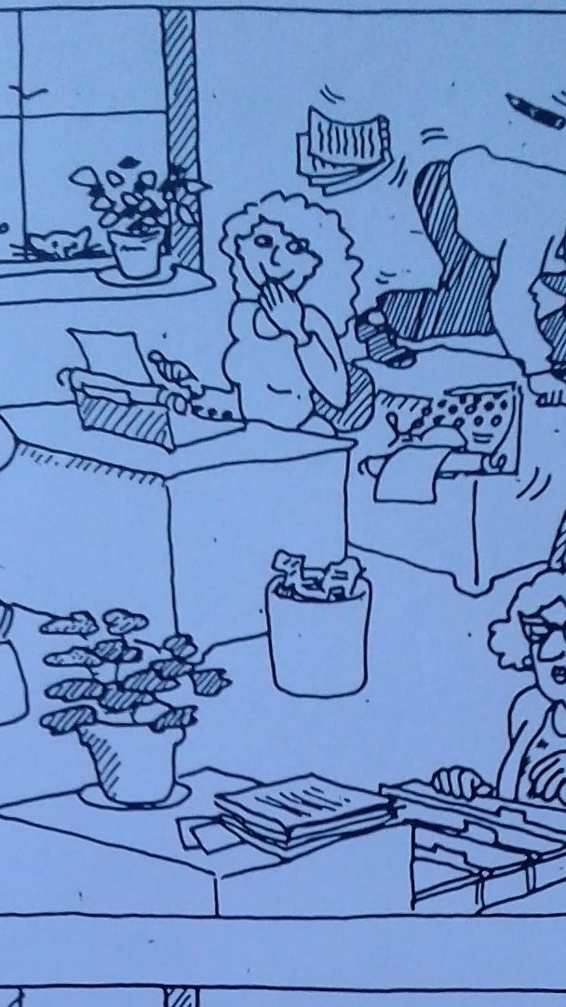
Differences in
the office scenes
(Find 10 differences
between A & B)

Slide 2
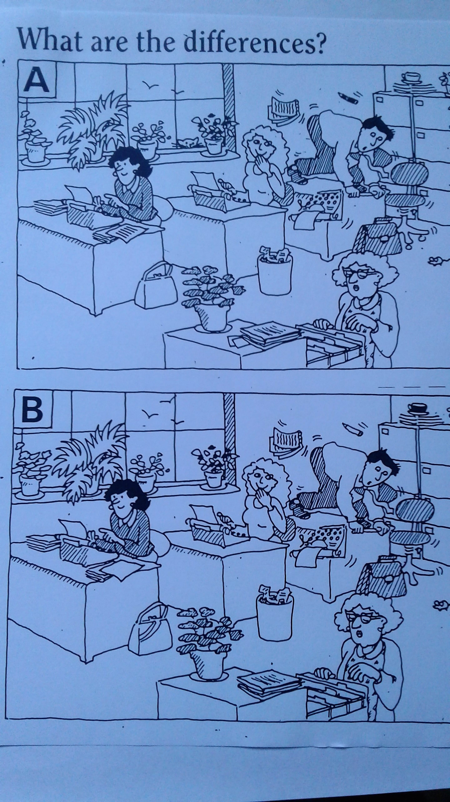

Slide 3
Differences between picture A and B:
A in the window has two birds and B has three birds.

Slide 4
Differences between picture A and B:
A in the window has two birds and B has three birds.
On the window sill in A the plant on the left has fewer leaves than in B.

Slide 5
Differences between picture A and B:
A in the window has two birds and B has three birds.
On the window sill in A the plant on the left has fewer leaves than in B.
On the window sill in A there is a cat but not in B.

Slide 6
Differences between picture A and B:
A in the window has two birds and B has three birds.
On the window sill in A the plant on the left has fewer leaves than in B.
On the window sill in A there is a cat but not in B.
On the filing cabinet, A has a white coffee cup and B has a black cup.

Slide 7
In A, the filing cabinet on the right has a handle for the top drawer, but no handle in B.

Slide 8
In A, the filing cabinet on the right has a handle for the top drawer, but no handle in B.
In A, the man’s desk chair has wheels, but in B, there are no wheels.

Slide 9
In A, the filing cabinet on the right has a handle for the top drawer, but no handle in B.
In A, the man’s desk chair has wheels, but in B, there are no wheels.
At front desk, A has writing on paper,
in B the paper is blank.

Slide 10
In A, the filing cabinet on the right has a handle for the top drawer, but no handle in B.
In A, the man’s desk chair has wheels, but in B, there are no wheels.
At front desk, A has writing on paper,
in B the paper is blank.

Slide 11
At the front desk, the lady’s purse in A
has no design on the side and B has a
design.

Slide 12
At the front desk, the lady’s purse in A
has no design on the side and B has a
design.
In A, the pencil above the man is
black, in B the pencil is white.

Slide 13
At the front desk, the lady’s purse in A
has no design on the side and B has a
design.
In A, the pencil above the man is
black, in B the pencil is white.
In A, the lady at the filing cabinet has
two pieces of paper under the stack of
papers, in B there aren’t any papers.

Slide 14
THE END

Slide 15
CREDIT: KEEP TALKING page 149
Cambridge University Press
Tenth printing 1992

