Slide 2
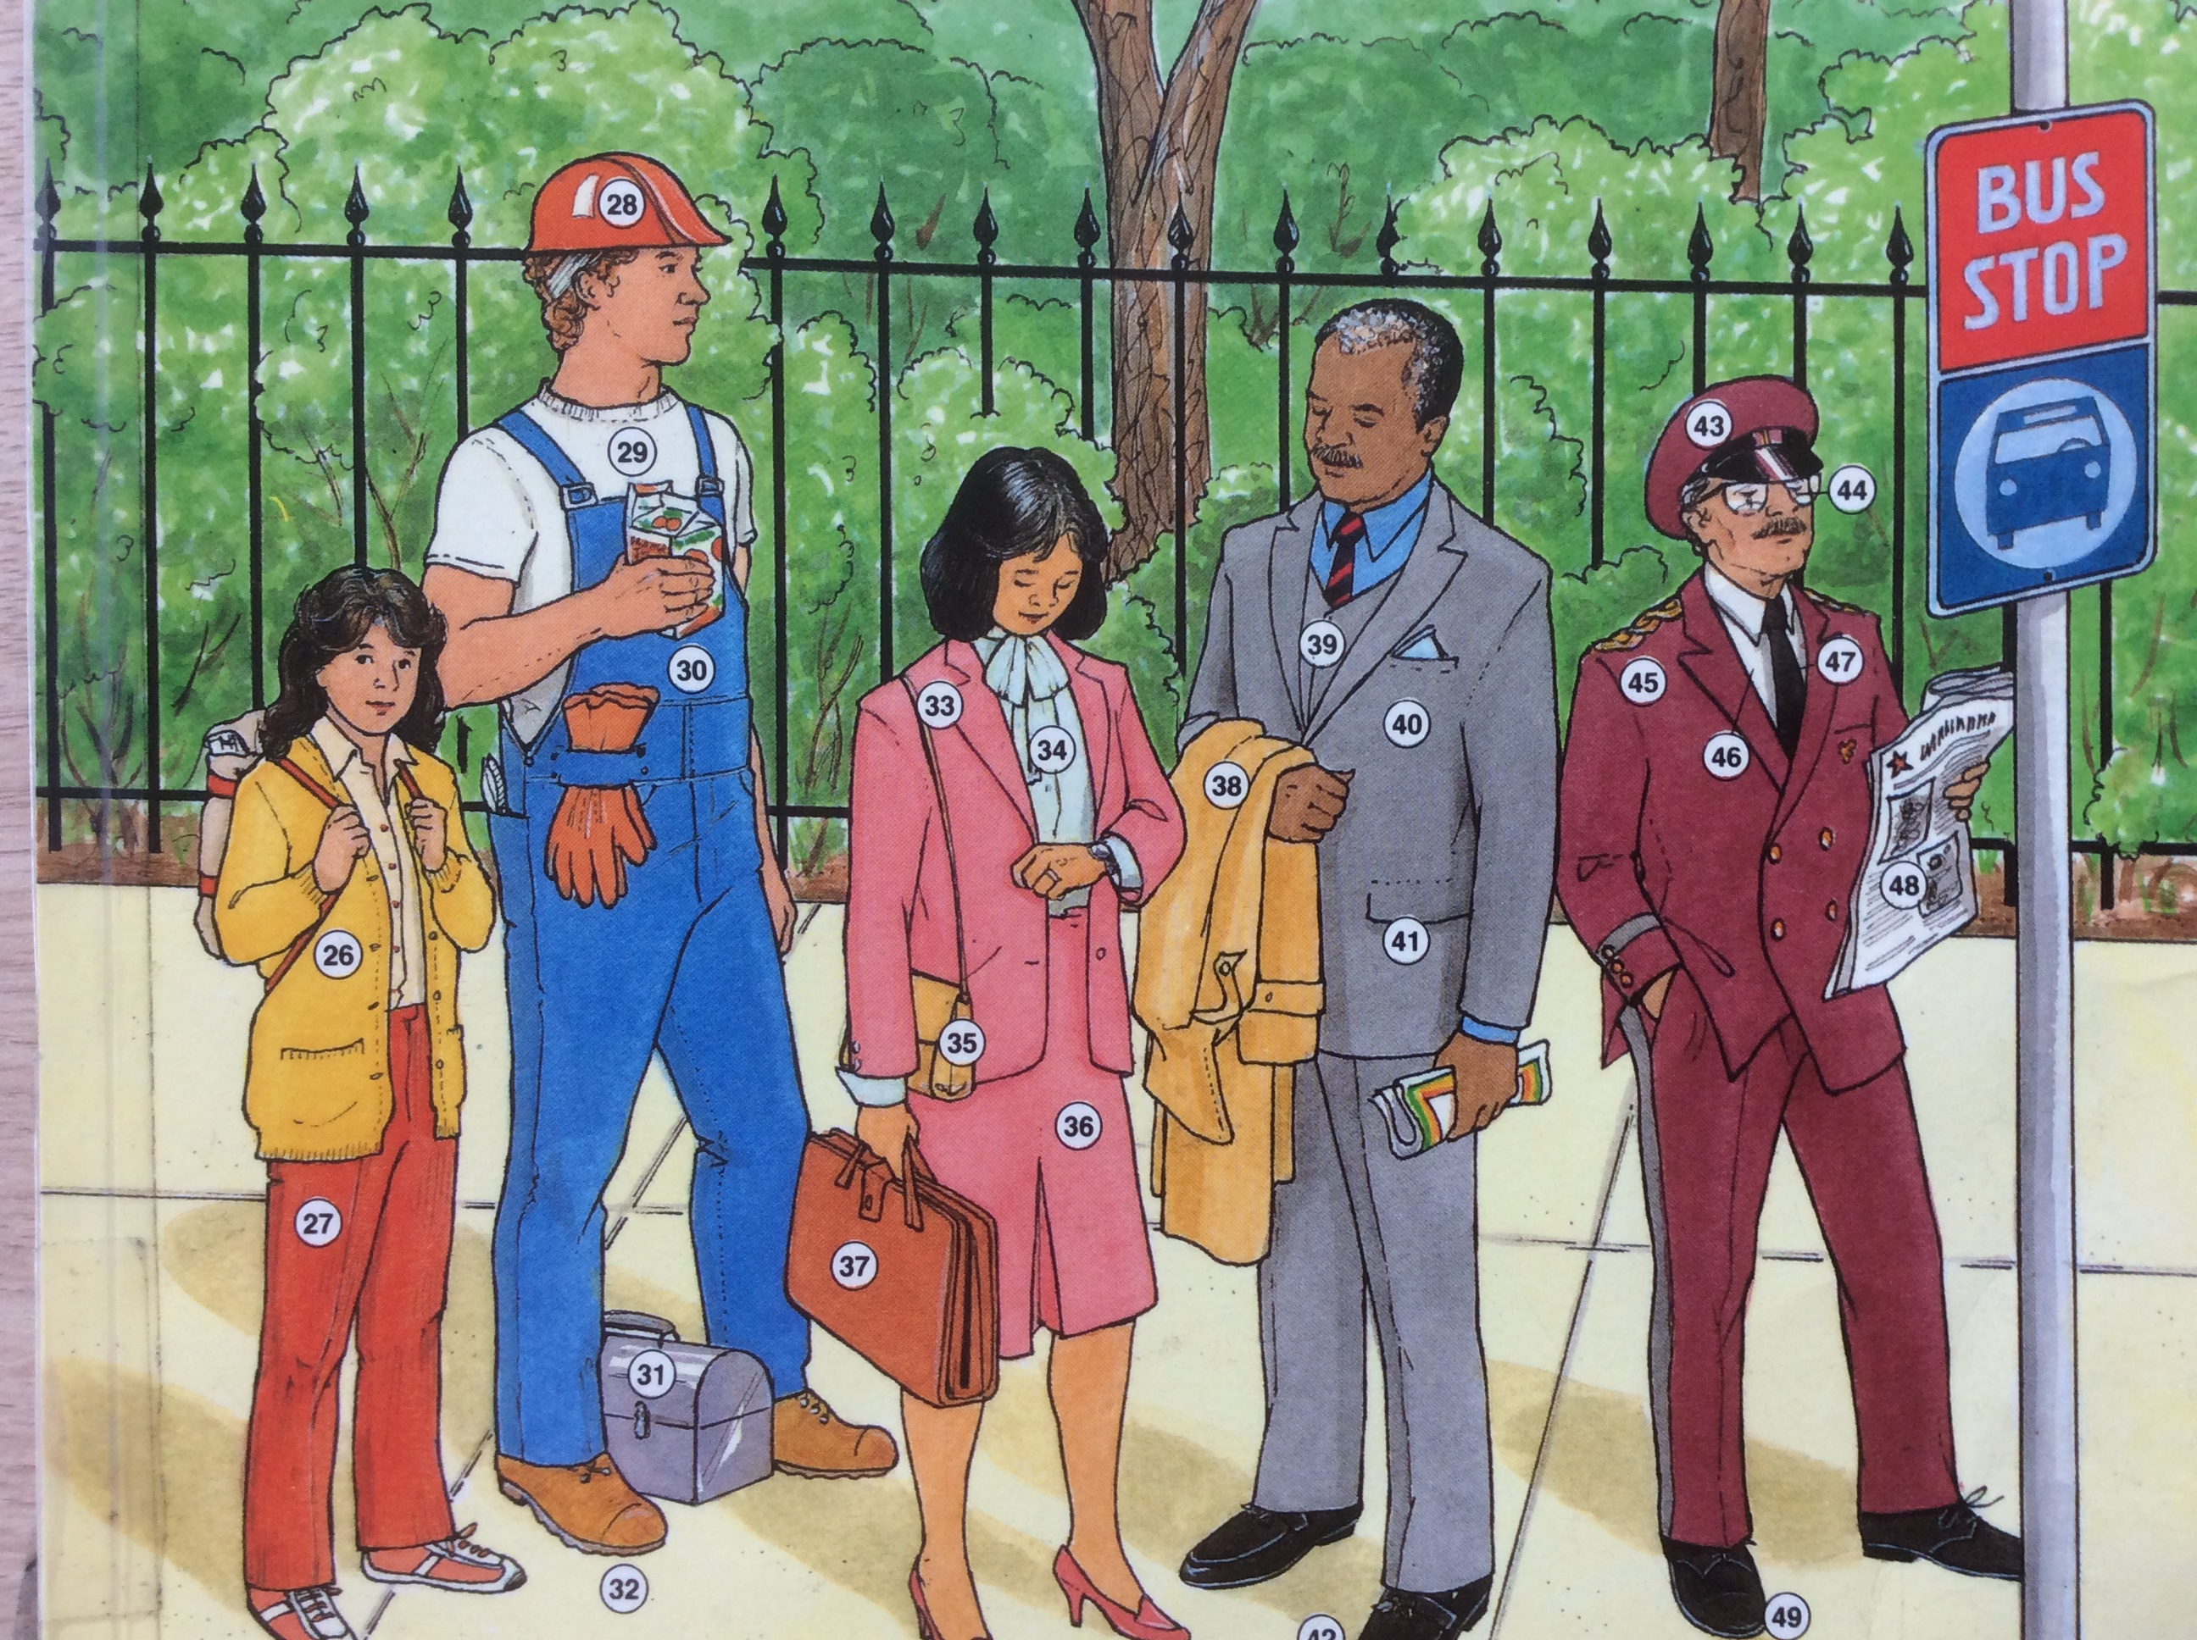
AT THE BUS STOP
IN NEW YORK CITY

Slide 3
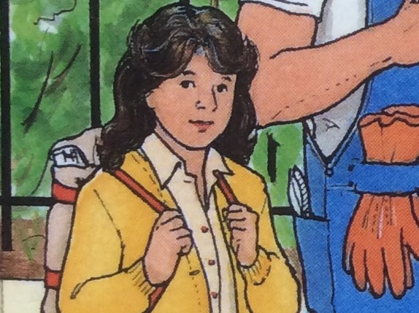
Pauline: Age 16 Nationality: French
Daughter of a diplomat. Student in a US high school for three years. She
is bilingual. Wants to be an artist.
Hobbies: painting,
tennis

Slide 4
Pedro – Age 25. Nationality: Mexican
In the US for two years. Employed as a carpenter by an American construction company. Married, father of two small children ages 2 & 3.
Enjoys watching
football (soccer)

Slide 5
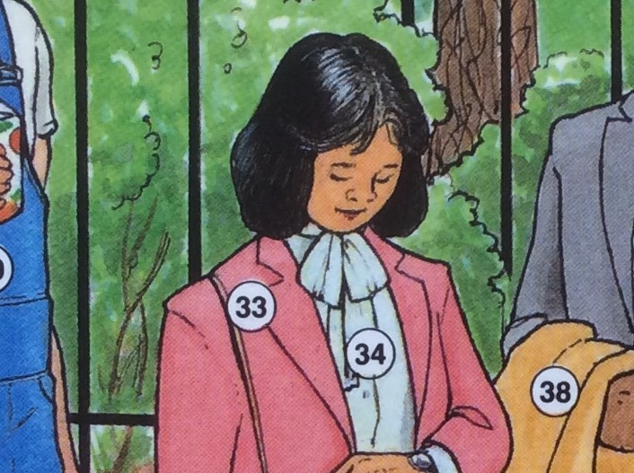
Mikiko Age 33. Nationality:Japanese
Occupation: US representative for Japanese company, Sony Electronics.
Single, speaks Japanese, English,Thai, and Chinese.
Hobbies:Asian cuisine
Asian art

Slide 6
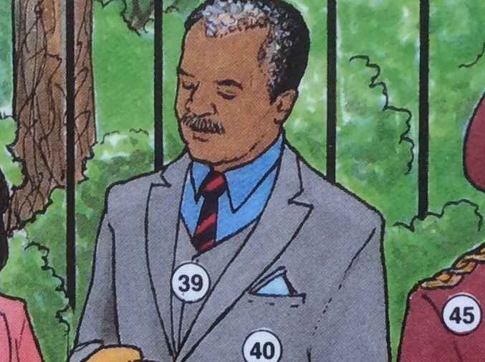
Dr. Abulu Age 52. Nationality: US originally from Kenya
Medical doctor working in a hospital. Married for 30 years, father of three children ages 29,27and 21.
Hobbies:raises toy
French poodle dogs
And collects stamps.

Slide 7
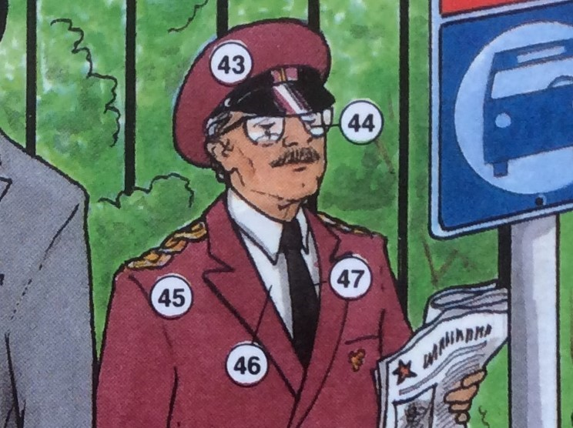
Andrew Age 61 Nationality: US
Occupation: Doorman and valet for 4 star hotel. Married for 38 years.
Hobbies: geography
history

Slide 8
AT THE BUS STOP
IN NEW YORK CITY

Slide 9
Who could help…….?

Slide 10
Who could help…….?
give you directions to the United Nations
Building?

Slide 11
Who could help…….?
give you directions to the United Nations
Building?
2) tell you about the World Cup?

Slide 12
Who could help…….?
give you directions to the United Nations
Building?
2) tell you about the World Cup?
3) help you move furniture in your new
apartment?

Slide 13
Who could help…….?
give you directions to the United Nations
Building?
2) tell you about the World Cup?
3) help you move furniture in your new
apartment?

Slide 14
Who could help…….?
give you directions to the United Nations
Building?
2) tell you about the World Cup?
3) help you move furniture in your new
apartment?
4) Suggest a restaurant that serves Indian
food?

Slide 15
Who could help…….?
give you directions to the United Nations
Building?
2) tell you about the World Cup?
3) help you move furniture in your new
apartment?
4) Suggest a restaurant that serves Indian
food?
5) tell you about AIDS?

Slide 16
Who could help…….?
give you directions to the United Nations
Building?
2) tell you about the World Cup?
3) help you move furniture in your new
apartment?
4) Suggest a restaurant that serves Indian
food?
5) tell you about AIDS?
6) Help you translate for tourists from
Brussels, Moscow, and Lima?

Slide 17
Who could help…….?
7) tell you how to get to New York’s
John F. Kennedy International Airport?

Slide 18
Who could help…….?
7) tell you how to get to New York’s
John F. Kennedy International Airport?
8) help you purchase a camera?

Slide 19
Who could help…….?
7) tell you how to get to New York’s
John F. Kennedy International Airport?
8) help you purchase a camera?
9) advise you about university studies?

Slide 20
Who could help…….?
7) tell you how to get to New York’s
John F. Kennedy International Airport?
8) help you purchase a camera?
9) advise you about university studies?
10) give you advice about children?

