Slide 2
Where are you when
you hear
the following….?

Slide 3
Open Wide!

Slide 4
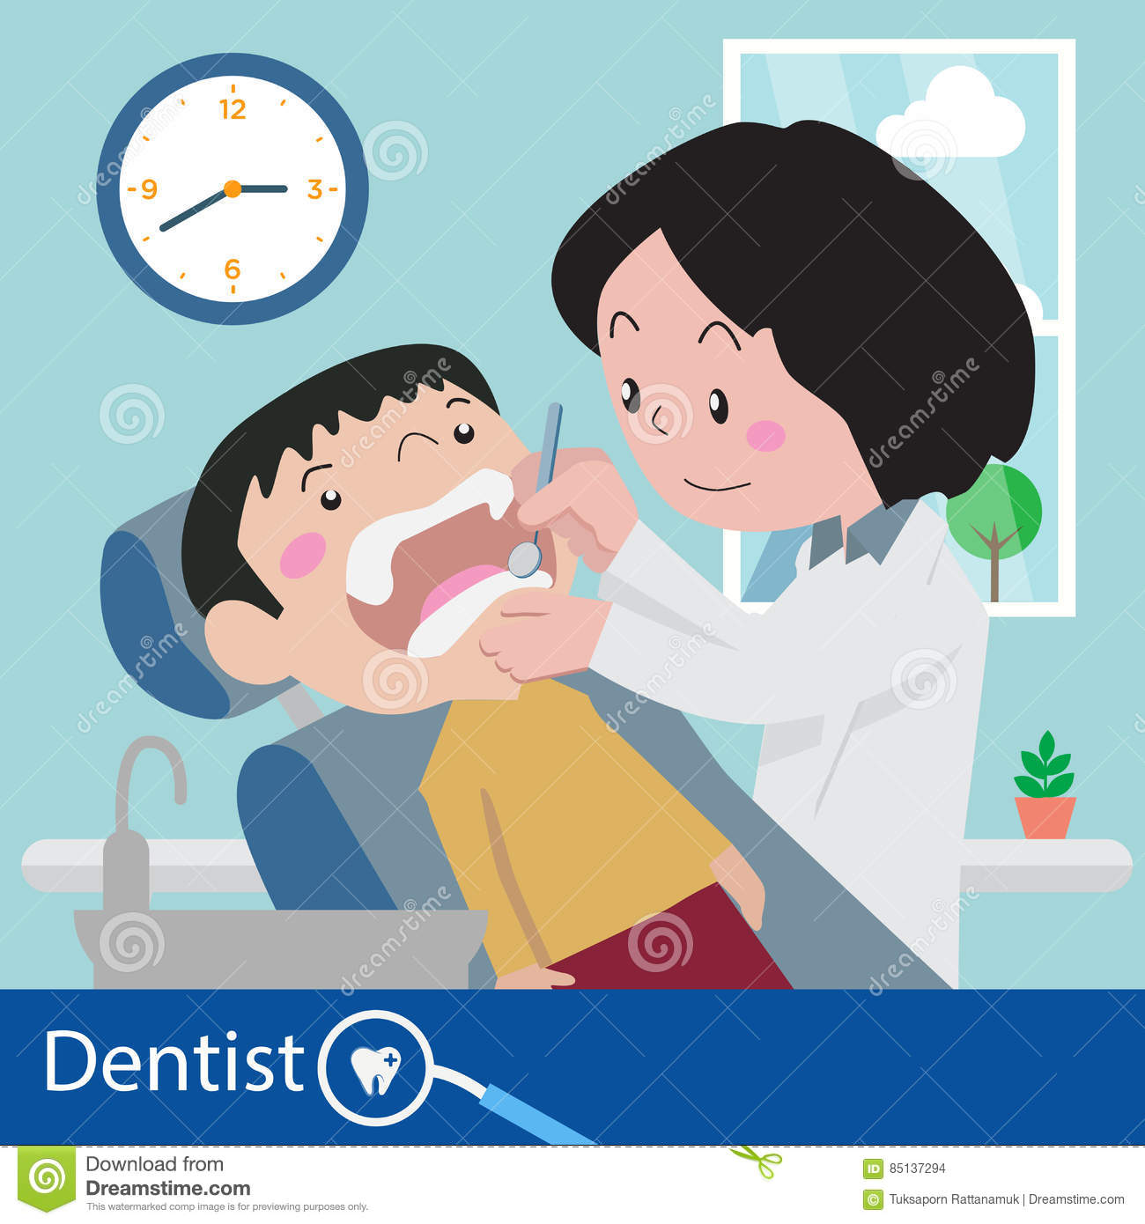

Slide 5
Raise the back of your
seat
to the upright position.

Slide 6
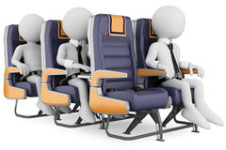

Slide 7
Do you want to try it on?

Slide 8
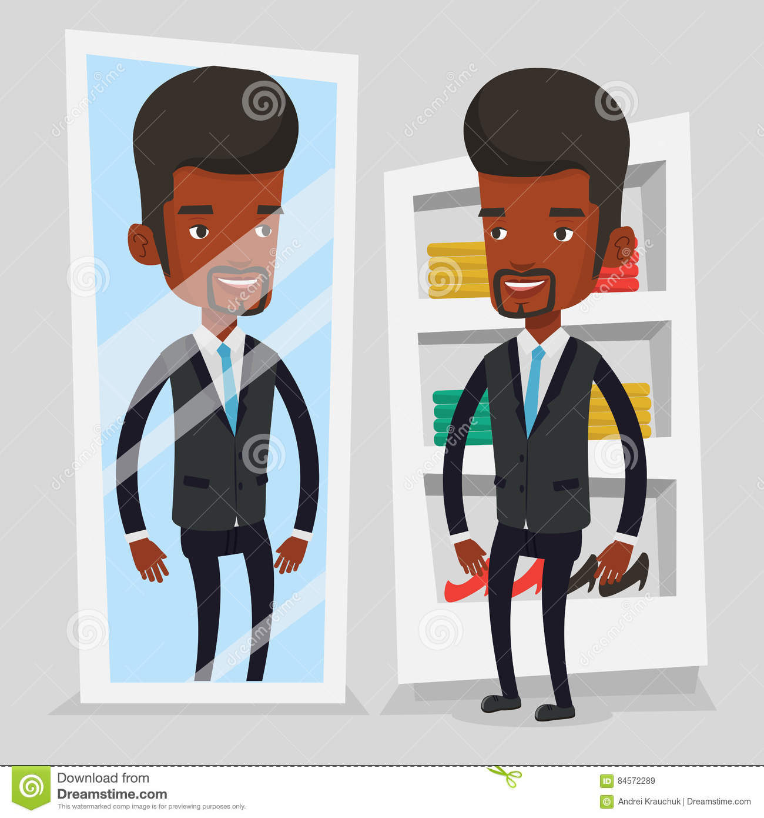

Slide 9
How would you like
the money?

Slide 10
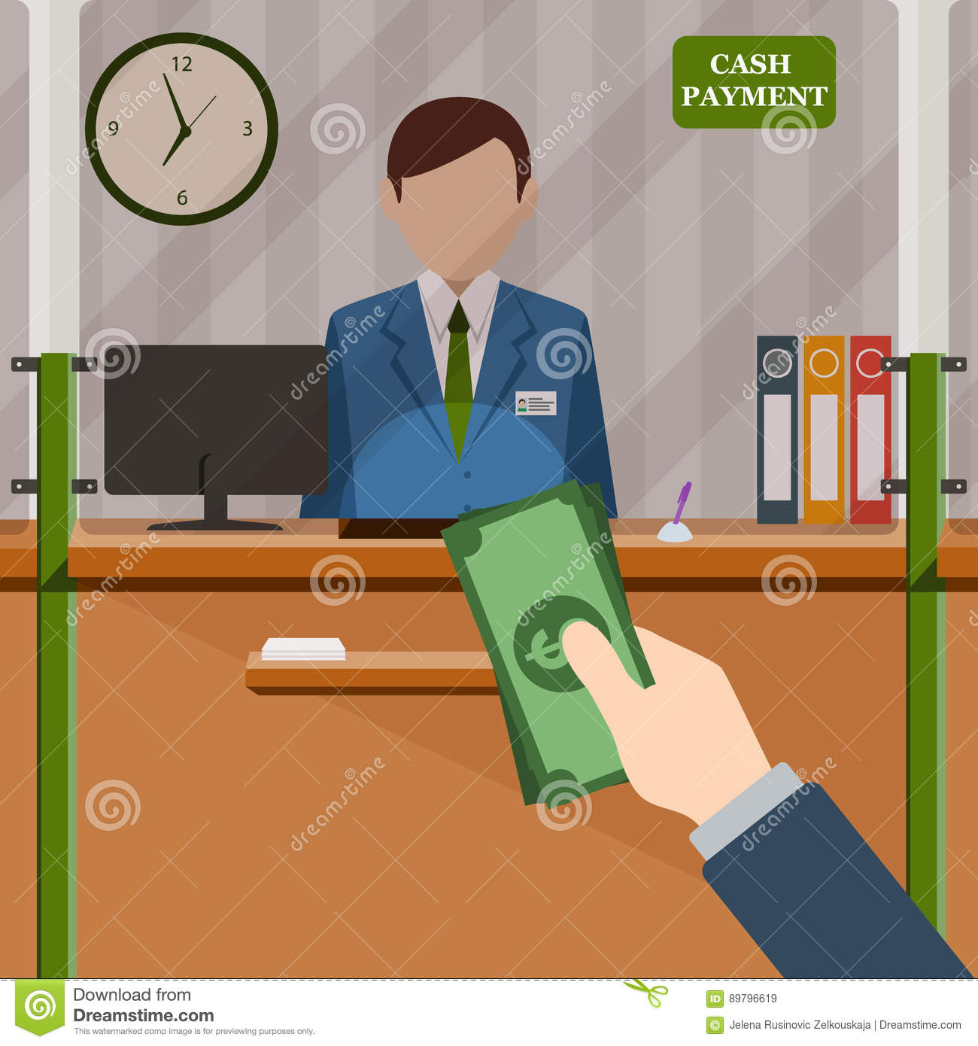

Slide 11
Rare, medium or well done?

Slide 12
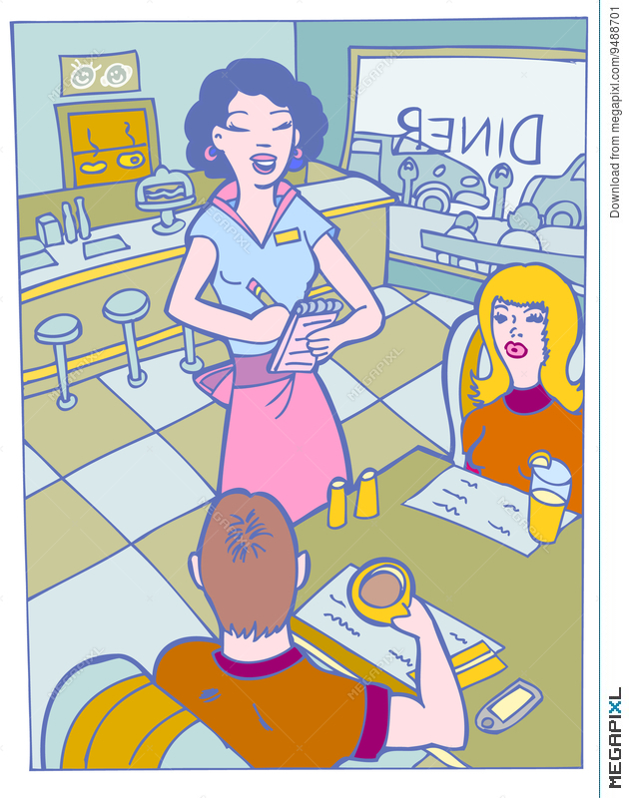

Slide 13
Say ‘cheese’!

Slide 14


Slide 15
Going down?

Slide 16
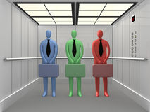

Slide 17
Down in front!

Slide 18
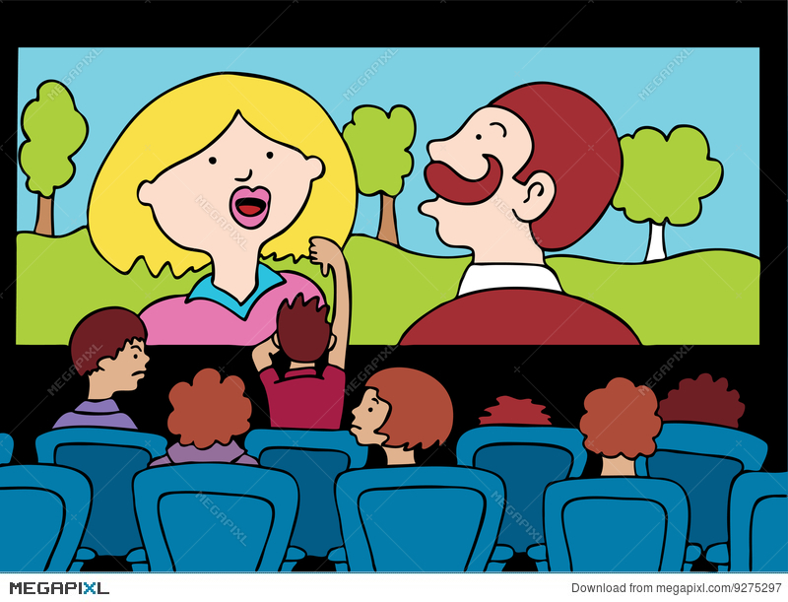

Slide 19
The End

