Slide 1
TRUE SAYINGS
Proverbs and clichés
Explain the meaning of the following…

Slide 2

1.
“The way to a man’s heart is through his stomach.”

Slide 3
Meaning:
Cooking food for a man is a good way to win his affections.

Slide 4


2.
“Honey catches more flies
than vinegar”

Slide 5
Meaning:
It is more effective to be polite and flattering than to be hostile or demanding.

Slide 6

3.
“Give a man a fish, and you feed him for a day; teach him to fish and you feed him for a lifetime.”

Slide 7
Meaning:
“Teach a man a skill or trade, and you’ve fed him for a lifetime."

Slide 8

4.
“Don’t cry over spilled milk.”

Slide 9
Meaning:
It doesn't do any good to be unhappy about something that has already happened or that can't be helped

Slide 10

5.
“A tree is known by its fruit.”

Slide 11
Meaning:
A person is known by his ‘fruit’, or his deeds…what he is and what he does.

Slide 12

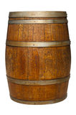
6.
“One rotten apple spoils the whole barrel.”

Slide 13
Meaning:
A single bad influence can ruin what would otherwise remain good.

Slide 14

7.
“An apple a day keeps the doctor away.”

Slide 15
Meaning:
Eat nutritious food and you will be healthy.

Slide 16
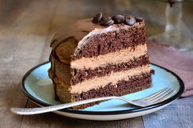
8.
“You cannot have your cake and eat it too!”

Slide 17
Meaning:
There is a limit to what you want and what you deserve.

Slide 18

9.
“There’s no such thing as a free lunch.”

Slide 19
Meaning:
“It isn't possible to get something for nothing.”.

Slide 20
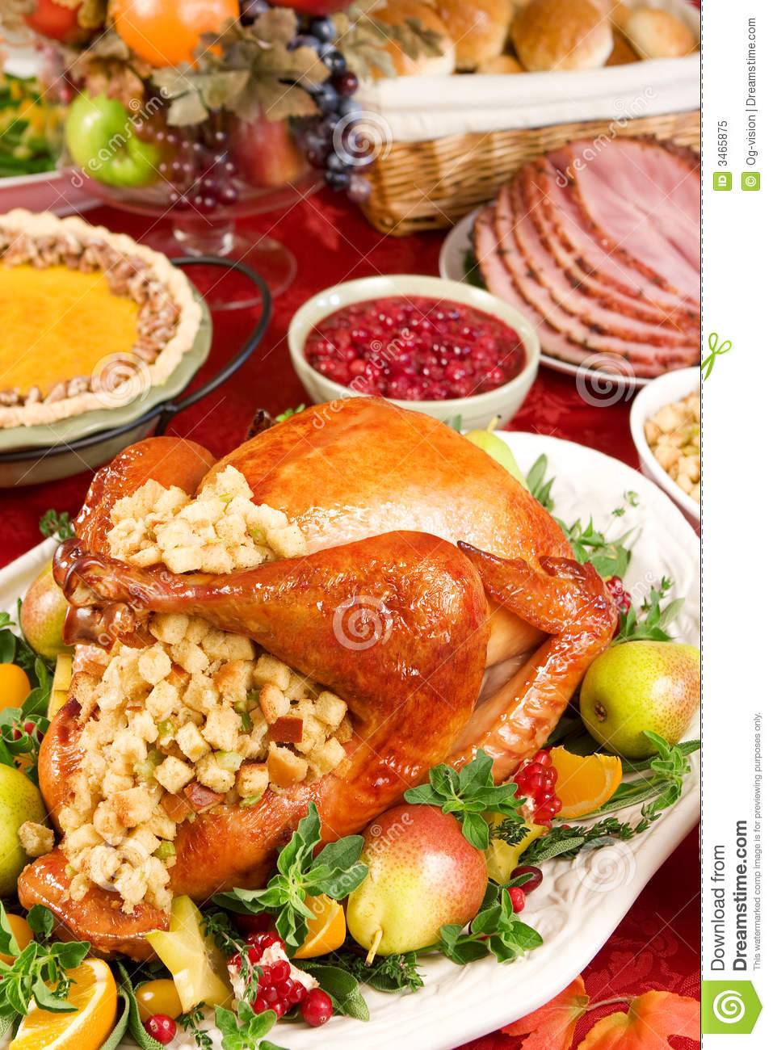
10.
“Enough is as good as a feast.”

Slide 21
Meaning:
”That there is no point in having more of something
than you need or want.”

Slide 22
THE END

