Slide 1
TRICK QUESTIONS

Slide 2
The following questions sound easy, but all require good logic. See how well you can do!

Slide 3
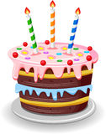
1) How many birth days does
an average person have?

Slide 4
Only one – he is only born once!

Slide 5
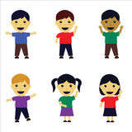
2) A pair of twins is how
many people?

Slide 6
TWO

Slide 7
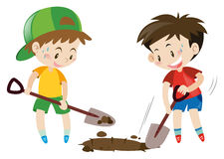
3) How much dirt is in a hole two meters deep, two meters wide and one meter long?

Slide 8
There is NO dirt in a hole!

Slide 9
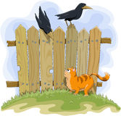
4) Fifteen crows are sitting on a fence. A farmer shoots one-third of them. How many are left?

Slide 10
None are left. The noise of the gun scared the rest of them away.

Slide 11
5) How can you rearrange the letters ‘ new door’ to make just one word?

Slide 12
ONE WORD!

Slide 13
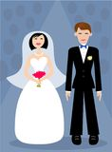
6) Is it legal for a man in this country to marry his widow’s sister?

Slide 14
No. He’s dead!
The wife is a widow.

Slide 15
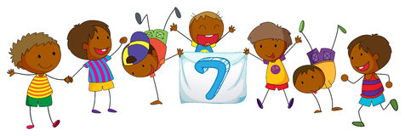
7) A woman has seven children, half of them are boys. How can this be possible?

Slide 16
All seven children are boys so half of them are boys.
It doesn’t say, “only half”.

Slide 17
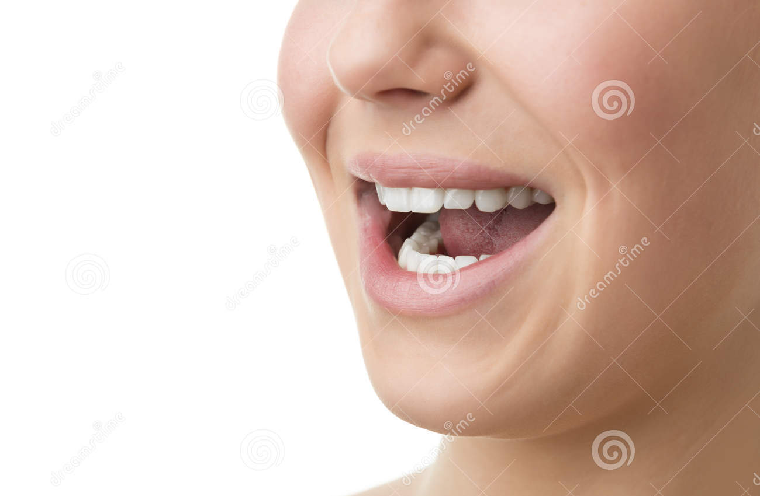
8) What five letter English word does every college graduate from this country pronounce wrong?

Slide 18
WRONG!

Slide 19
9) A doctor gives you three pills, telling you to take one every 30 minutes. How long will the pills last?

Slide 20
60 minutes: one at the beginning of the hour, one in the middle, one at the end of the hour

Slide 21
10) Seven months have 31 days. How many have 28 days?

Slide 22
All of them do!

Slide 23
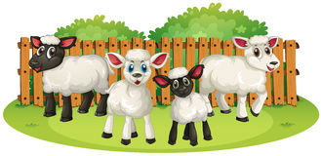
11) A farmer has 17 sheep.
All but nine of them die. How many are left?

Slide 24
NINE!

Slide 25
12) A man working in a butcher shop (meat market) is 190 cm tall. What does he weigh?
a scale

Slide 26
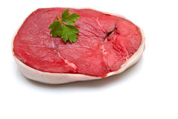
MEAT

Slide 27
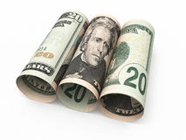
13) Why are 1990 American 20-dollar bills worth more than 1989 American 20 dollar bills?

Slide 28
There are more of them: 1,990 compared to 1,989
1990 $20 bills
1989 $20 bills

Slide 29
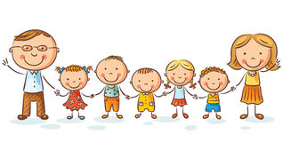
Mr & Mrs. Smith have five daughters. Each daughter has a brother. How many people are in the Smith family?

Slide 30
Eight!
Mr. & Mrs. Smith, five daughters and one son.

Slide 31
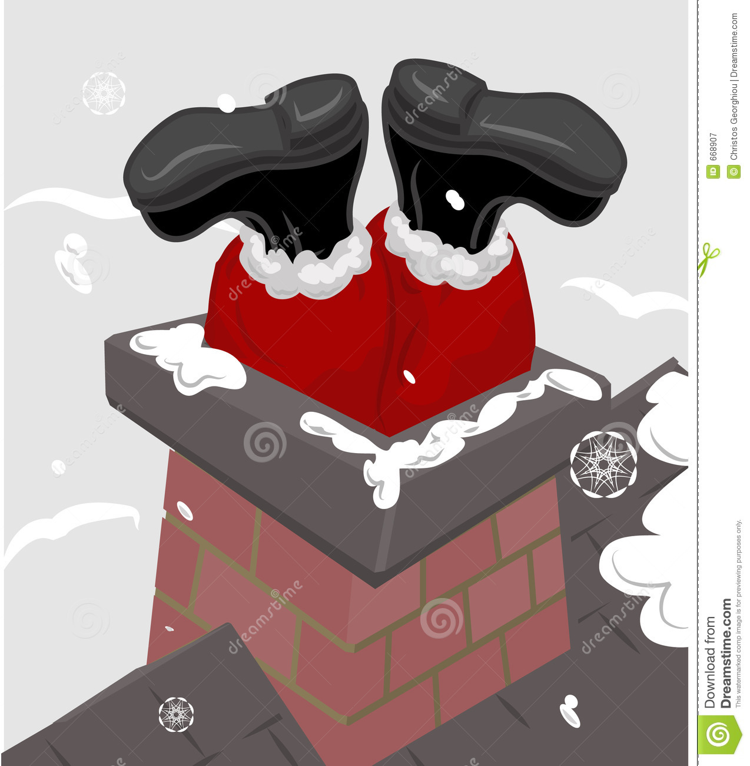
15) What can go up a chimney down, but can’t go down a chimney up?

Slide 32
An Umbrella
‘down’ ‘up’

Slide 33
THE END

