Slide 1
Street Scene
(using the simple present tense)

Slide 2
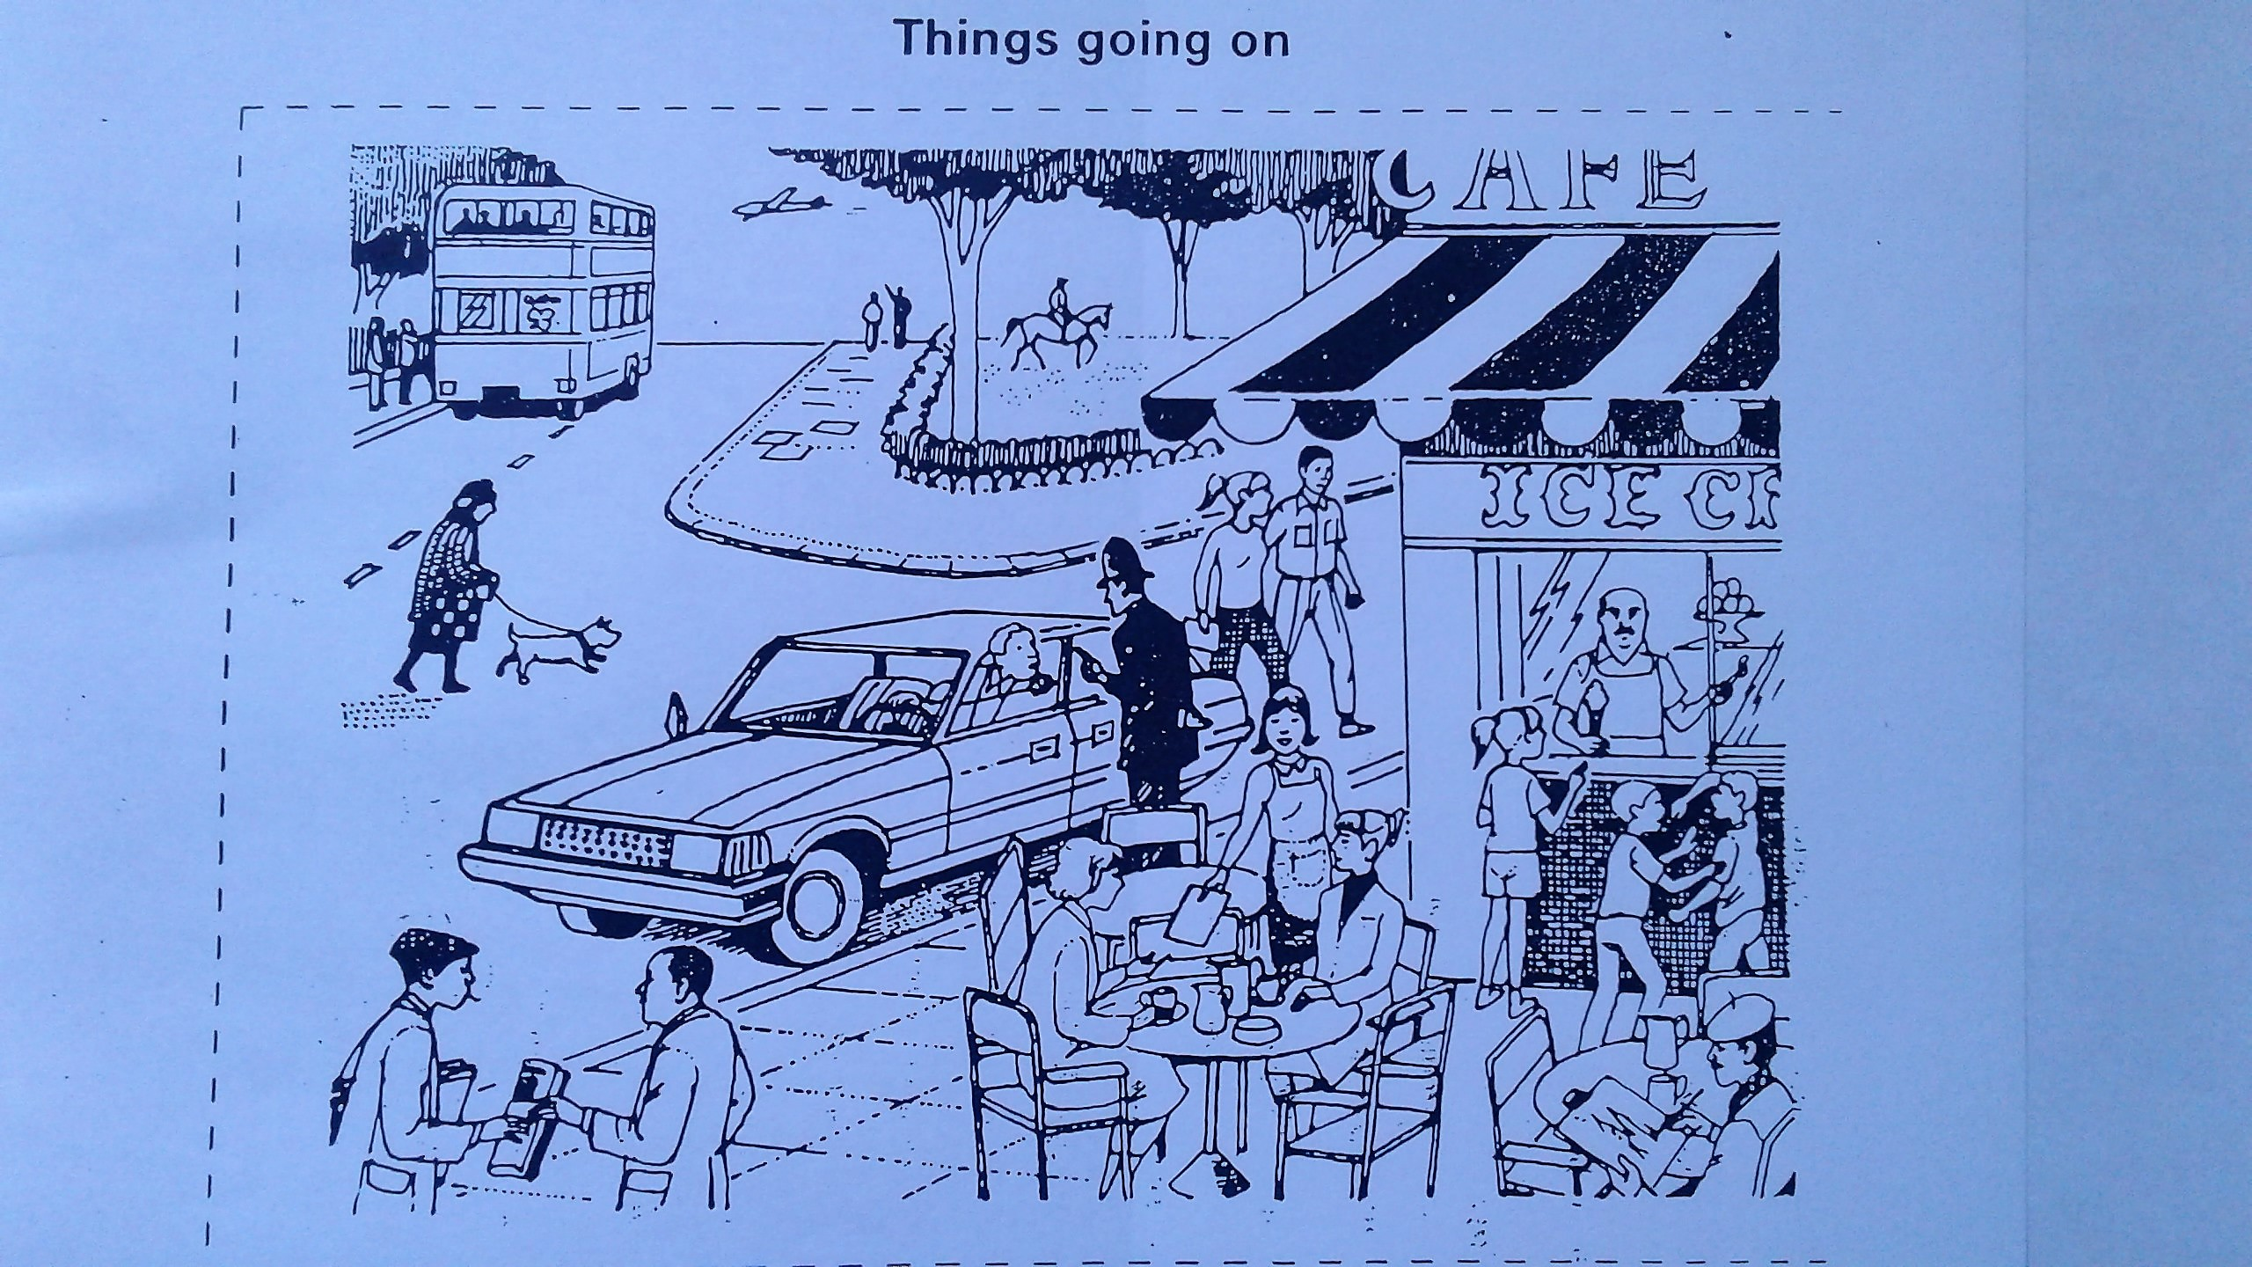
Describe the actions in simple present tense.

Slide 3
The bus stops for passengers

Slide 4
The bus stops for passengers
An airplane flies in the sky.

Slide 5
The bus stops for passengers
An airplane flies in the sky.
A man on the sidewalk points to the airplane.

Slide 6
The bus stops for passengers
An airplane flies in the sky.
A man on the sidewalk points to the airplane.
A man rides on a horse in the park.

Slide 7
The bus stops for passengers
An airplane flies in the sky.
A man on the sidewalk points to the airplane.
A man rides on a horse in the park.
A lady walks with her dog across the street.

Slide 8
A policeman talks to a driver.

Slide 9
A policeman talks to a driver.
A couple cross the street.

Slide 10
A policeman talks to a driver.
A couple cross the street.
A server gives the bill to the ladies at the table.

Slide 11
A policeman talks to a driver.
A couple cross the street.
A server gives the bill to the ladies at the table.
A girl stands at the window and gets an ice cream cone.

Slide 12
A policeman talks to a driver.
A couple cross the street.
A server gives the bill to the ladies at the table.
A girl stands at the window and gets an ice cream cone.
Two boys fight in front of the store.

Slide 13
A man paints a pictures.

Slide 14
A man paints a pictures.
A man buys a newspaper.

Slide 15
The End

Slide 17
Street Scene
(using the simple past tense)

Slide 18
Describe the actions in simple past tense.

Slide 19
The bus stopped for passengers

Slide 20
The bus stopped for passengers
An airplane flew in the sky.

Slide 21
The bus stopped for passengers
An airplane flew in the sky.
A man on the sidewalk pointed to the airplane.

Slide 22
The bus stopped for passengers
An airplane flew in the sky.
A man on the sidewalk pointed to the airplane.
A man rode on a horse in the park.

Slide 23
The bus stopped for passengers
An airplane flew in the sky.
A man on the sidewalk pointed to the airplane.
A man rode on a horse in the park.
A lady walked with her dog across the street.

Slide 24
A policeman talked to a driver.

Slide 25
A policeman talked to a driver.
A couple crossed the street.

Slide 26
A policeman talked to a driver.
A couple crossed the street.
A server gave the bill to the ladies at the table.

Slide 27
A policeman talked to a driver.
A couple crossed the street.
A server gave the bill to the ladies at the table.
A girl stood at the window and gets an ice cream cone.

Slide 28
A policeman talked to a driver.
A couple crossed the street.
A server gave the bill to the ladies at the table.
A girl stood at the window and gets an ice cream cone.
Two boys fought in front of the store.

Slide 29
A man painted a pictures.

Slide 30
A man painted a pictures.
A man bought a newspaper.

Slide 31
The End

Slide 32
CREDIT: Grammar Practice Activities page 210
Cambridge University Press
Tenth printing 1992

