Slide 1
What is going on?
(using present progressive tense)

Slide 2
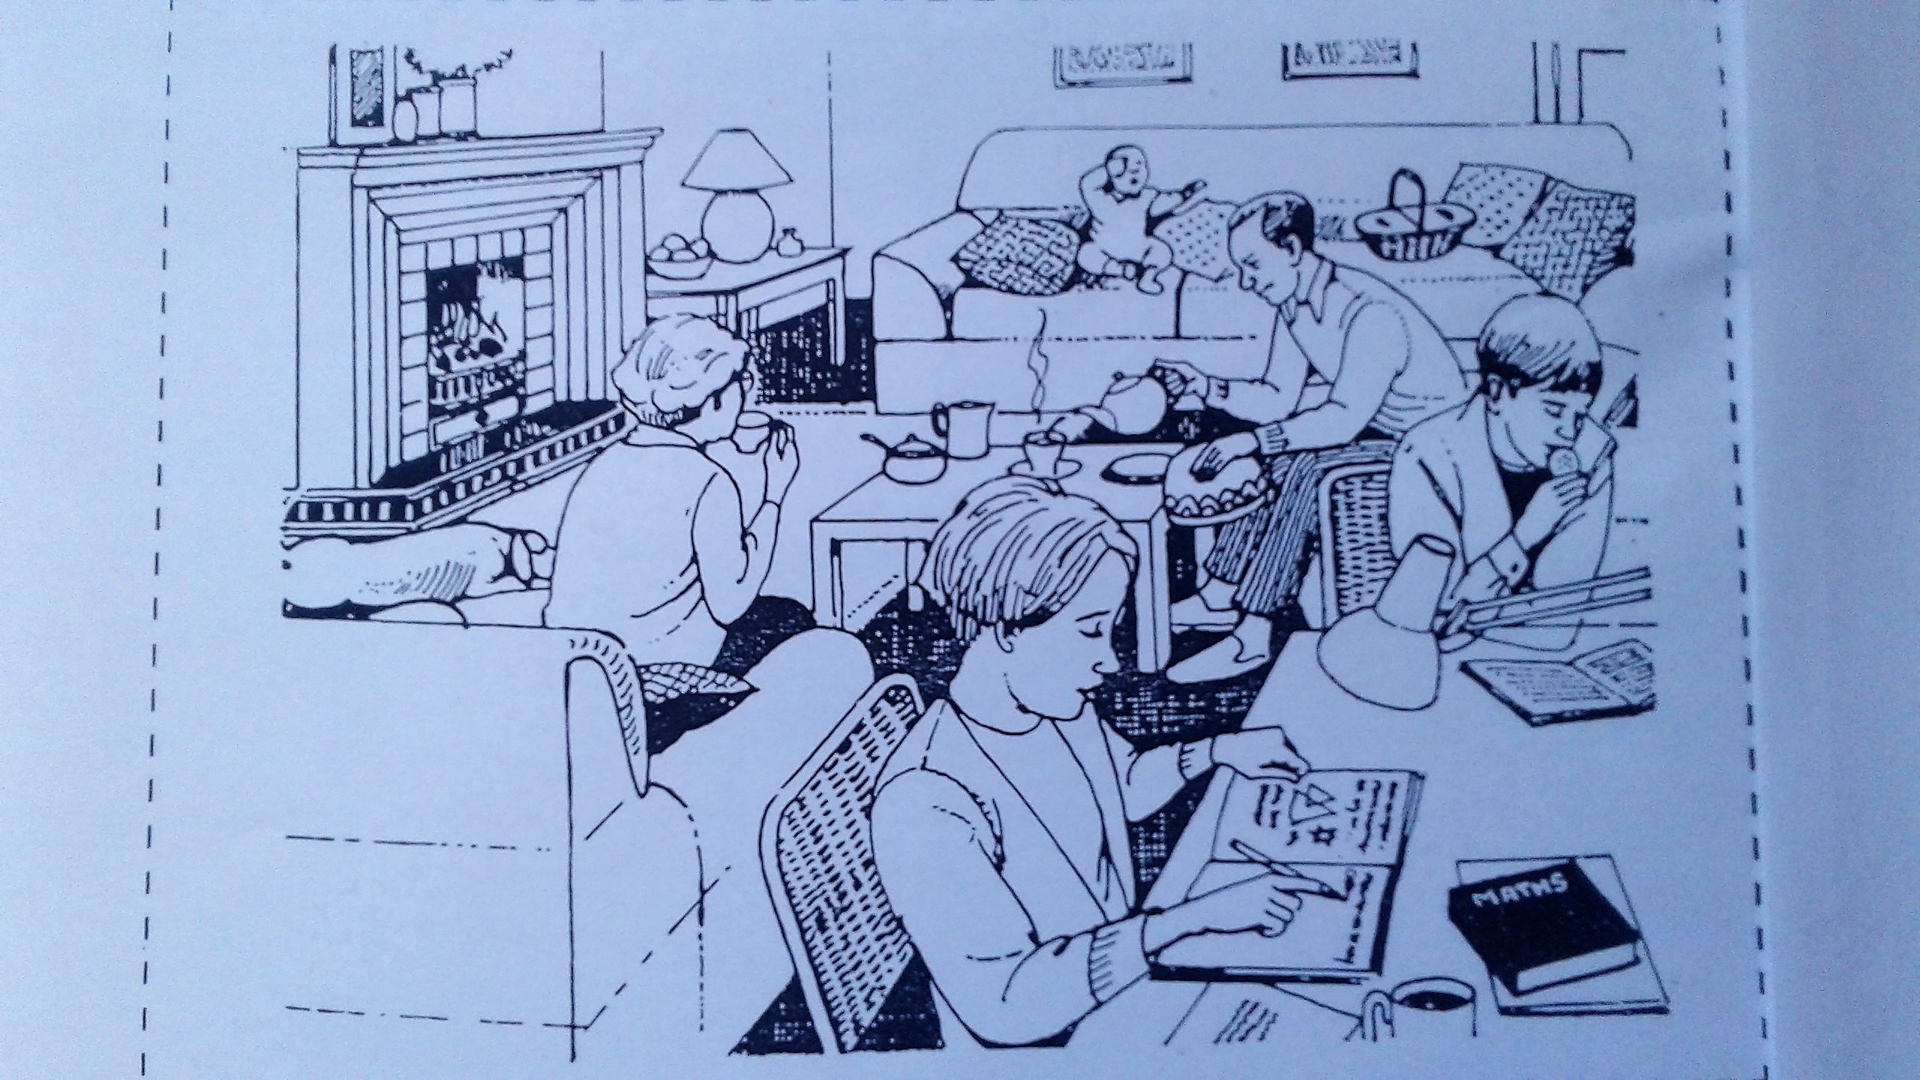
The living room

Slide 3
The baby on the couch (sofa) is crying.

Slide 4
The baby on the couch (sofa) is crying.
The man is pouring tea into a cup.

Slide 5
The baby on the couch (sofa) is crying.
The man is pouring tea into a cup.
The man is holding the cover to the tea pot in his hand.

Slide 6
The baby on the couch (sofa) is crying.
The man is pouring tea into a cup.
The man is holding the cover to the
tea pot in his hand.
The boy is reading a book and eating a
cracker or cookie.

Slide 7
5. The girl at the table is doing math
homework.

Slide 8
5. The girl at the table is doing math
homework.
The lady on the sofa is drinking tea or
coffee.

Slide 9
5. The girl at the table is doing math
homework.
The lady on the sofa is drinking tea or
coffee.
7. The dog is lying next to the fireplace.

Slide 10
5. The girl at the table is doing math
homework.
The lady on the sofa is drinking tea or
coffee.
7. The dog is lying next to the fireplace.
8. There is a fire burning in the fireplace.

Slide 11
The End

Slide 13
What was going on?
(using past progressive tense)

Slide 14
The living room

Slide 15
The baby on the couch (sofa) was crying.

Slide 16
The baby on the couch (sofa)was crying.
The man was pouring tea into a cup.

Slide 17
The baby on the couch (sofa) was crying.
The man was pouring tea into a cup.
The man was holding the cover to the tea pot in his hand.

Slide 18
The baby on the couch (sofa) was crying.
The man was pouring tea into a cup.
The man was holding the cover to the
tea pot in his hand.
The boy was reading a book and eating a cracker or cookie.

Slide 19
5. The girl at the table was doing math
homework.

Slide 20
5. The girl at the table was doing math
homework.
The lady on the sofa was drinking tea or coffee.

Slide 21
5. The girl at the table was doing math
homework.
The lady on the sofa was drinking tea or coffee.
7. The dog was lying next to the
fireplace.

Slide 22
5. The girl at the table was doing math
homework.
The lady on the sofa was drinking tea or coffee.
The dog was lying next to the
fireplace.
There was a fire burning in the fireplace.

Slide 23
The End

Slide 24
CREDIT: Grammar Practice Activities page 149
Cambridge University Press
Tenth printing 1992

