Slide 1
Find the differences on the two tables
(there are 9 differences)

Slide 2
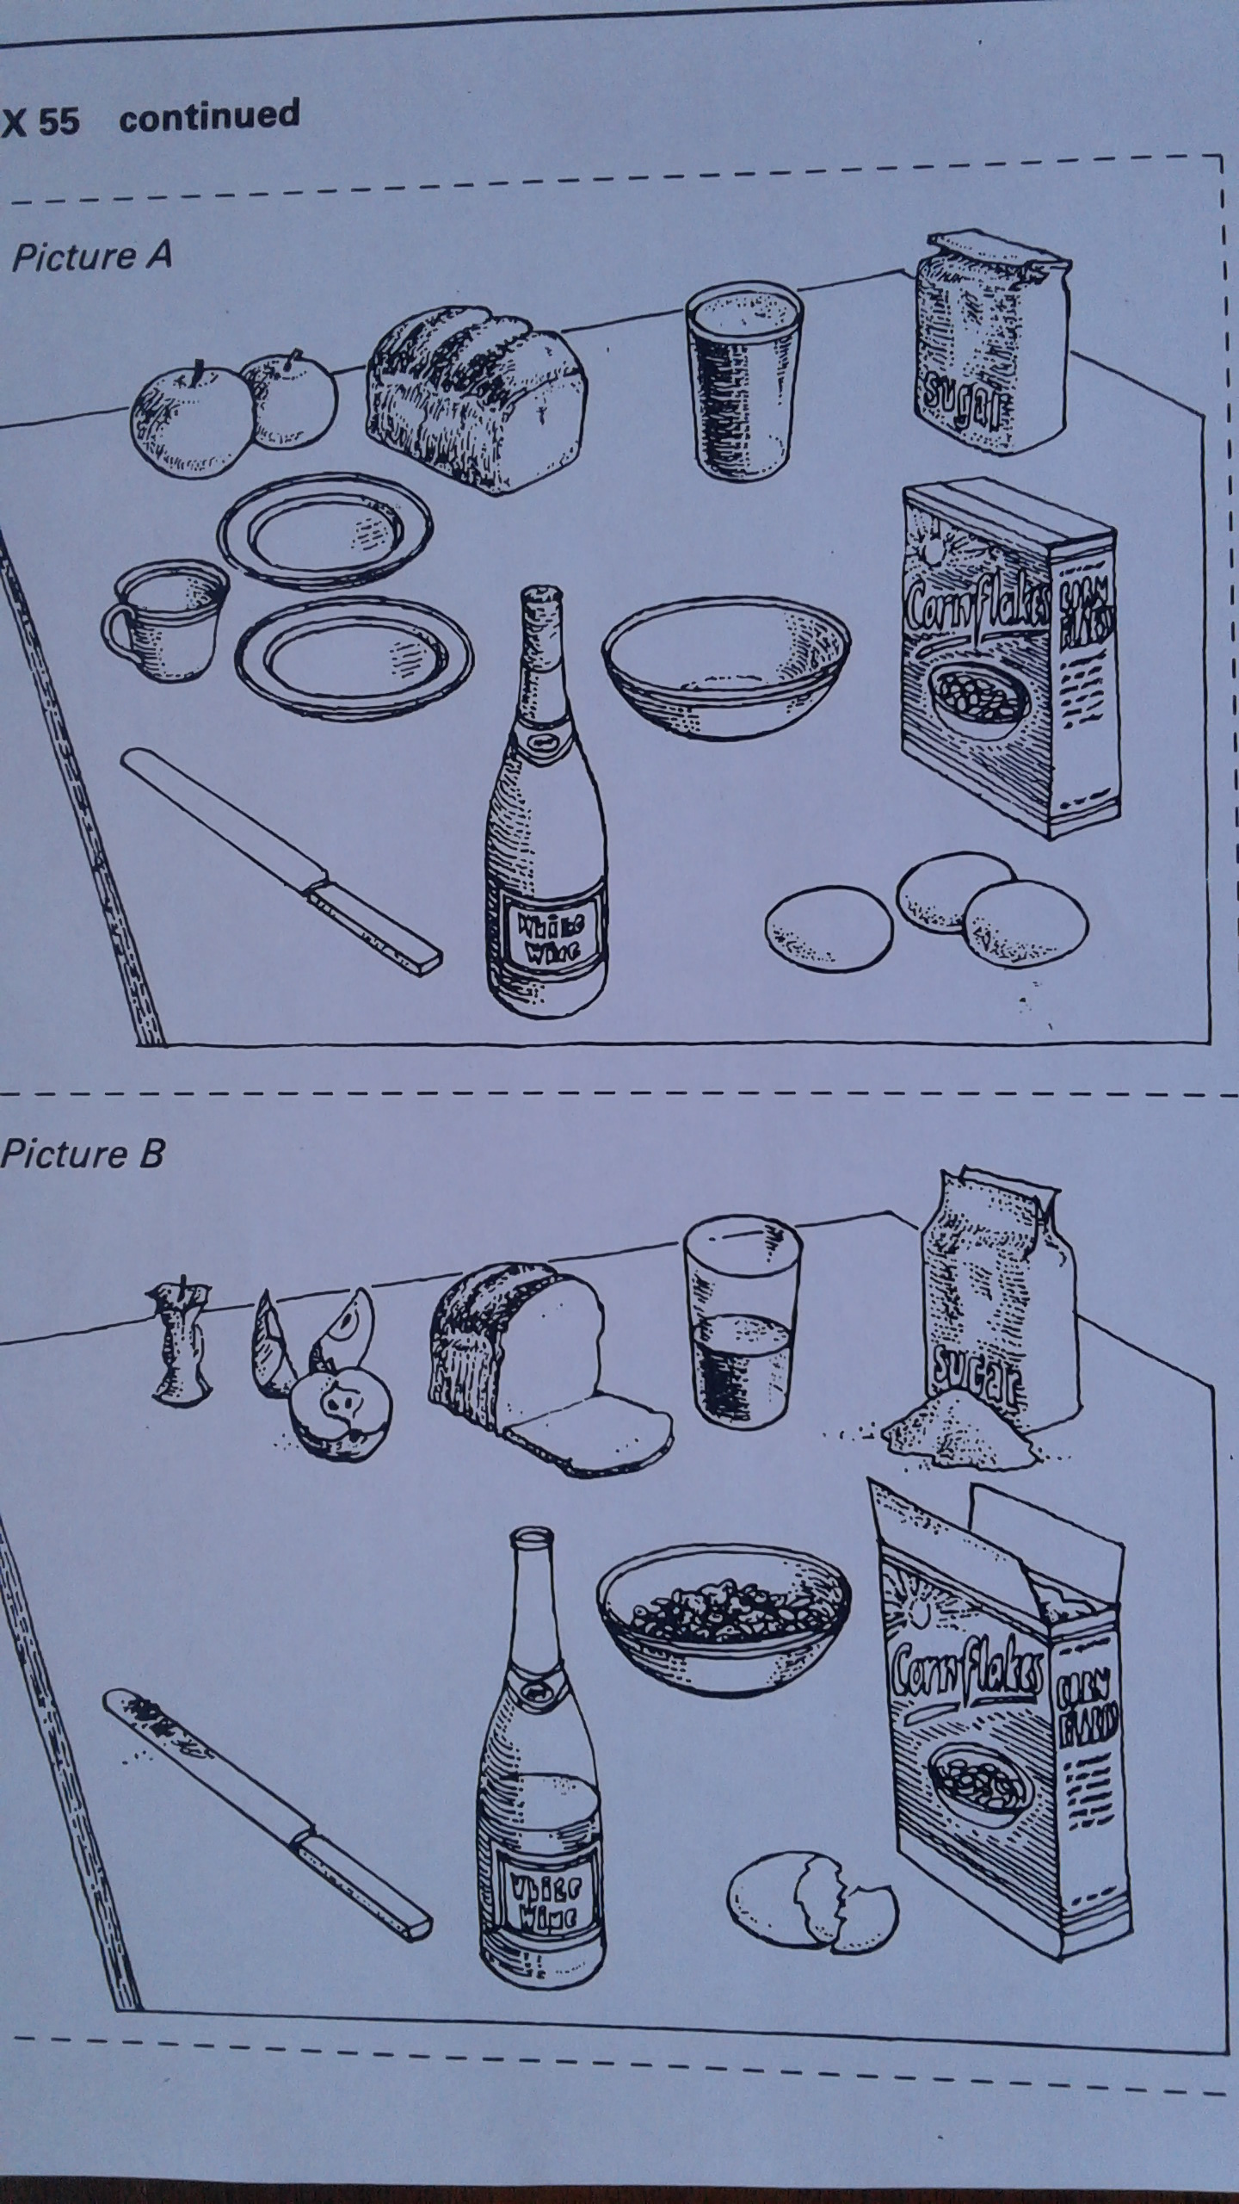

Slide 3
ANSWERS

Slide 4
In picture A the two apples are whole/uneaten, in picture B, one apple is eaten and the other is cut up in quarters and a half.
***The uneaten part of the apple is
called the ‘core’

Slide 5
In picture A, the loaf of bread is whole.
In picture B, a slide of bread is cut off.

Slide 6
In picture A, the glass is full. In picture
B the glass is half full.

Slide 7
In picture A, the sack of sugar is
unopened, in B the sack of sugar is
opened and there is some sugar on
the table.

Slide 8
In picture A, the knife is clean, in B the knife is dirty, or has been used.

Slide 9
In picture A, the bottle of white wine is not opened, in B some wine has been poured out of the bottle.

Slide 10
7. In picture A, the bowl is empty and the
box of corn flakes is closed/unopened,
in B the bowl has cereal and the box is
opened.

Slide 11
In picture A, there are three whole
eggs, in B there is one cracked open
egg.

Slide 12
9. In picture A, there is a cup with two
dishes, in B there aren’t any dishes or a
cup on the table.

Slide 13
THE END

Slide 14
CREDIT: Grammar Practice Activities page 200
Cambridge University Press
Tenth printing 1992

