Slide 1
Family Relations
Complete the following sentences with the name of the relative.

Slide 2
My uncle’s son is my ______.

Slide 3
My uncle’s son is my ______.
My brother’s daughter is my _____.

Slide 4
My uncle’s son is my ______.
My brother’s daughter is my _____.
My brother’s wife is my _____.

Slide 5
My uncle’s son is my ______.
My brother’s daughter is my _____.
My brother’s wife is my _____.
My father’s sister is my _____.

Slide 6
My uncle’s son is my ______.
My brother’s daughter is my _____.
My brother’s wife is my _____.
My father’s sister is my _____.
My father’s parents are my _____.

Slide 7
My uncle’s son is my ______.
My brother’s daughter is my _____.
My brother’s wife is my _____.
My father’s sister is my _____.
My father’s parents are my _____.
My mother’s husband is my _____.

Slide 8
My uncle’s son is my ______.
My brother’s daughter is my _____.
My brother’s wife is my _____.
My father’s sister is my _____.
My father’s parents are my _____.
My mother’s husband is my _____.
My mother’s mother is my _____.

Slide 9
My uncle’s son is my ______.
My brother’s daughter is my _____.
My brother’s wife is my _____.
My father’s sister is my _____.
My father’s parents are my _____.
My mother’s husband is my _____.
My mother’s mother is my _____.
My sister’s son is my _____.

Slide 10
My uncle’s son is my ______.
My brother’s daughter is my _____.
My brother’s wife is my _____.
My father’s sister is my _____.
My father’s parents are my _____.
My mother’s husband is my _____.
My mother’s mother is my _____.
My sister’s son is my _____.
My sister’s daughter’s brother’s father is my _____.

Slide 11
My uncle’s son is my ______.
My brother’s daughter is my _____.
My brother’s wife is my _____.
My father’s sister is my _____.
My father’s parents are my _____.
My mother’s husband is my _____.
My mother’s mother is my _____.
My sister’s son is my _____.
My sister’s daughter’s brother’s father is my _____’
My father’s mother’s grandchild is _____.
My grandfather’s father is my _________.

Slide 12
Answers

Slide 13

My uncle’s son is my
cousin

Slide 14

My brother’s daughter is my niece .

Slide 15

My brother’s wife is my
Sister-in-law.

Slide 16

My father’s sister is my
aunt.

Slide 17

My father’s parents are my
Paternal grandparents.

Slide 18

My mother’s husband is my
father / step-father

Slide 19
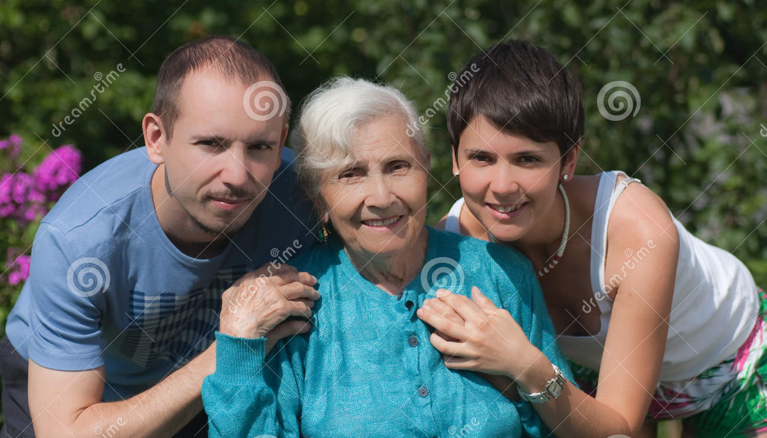
My mother’s mother is my
maternal grandmother

Slide 20
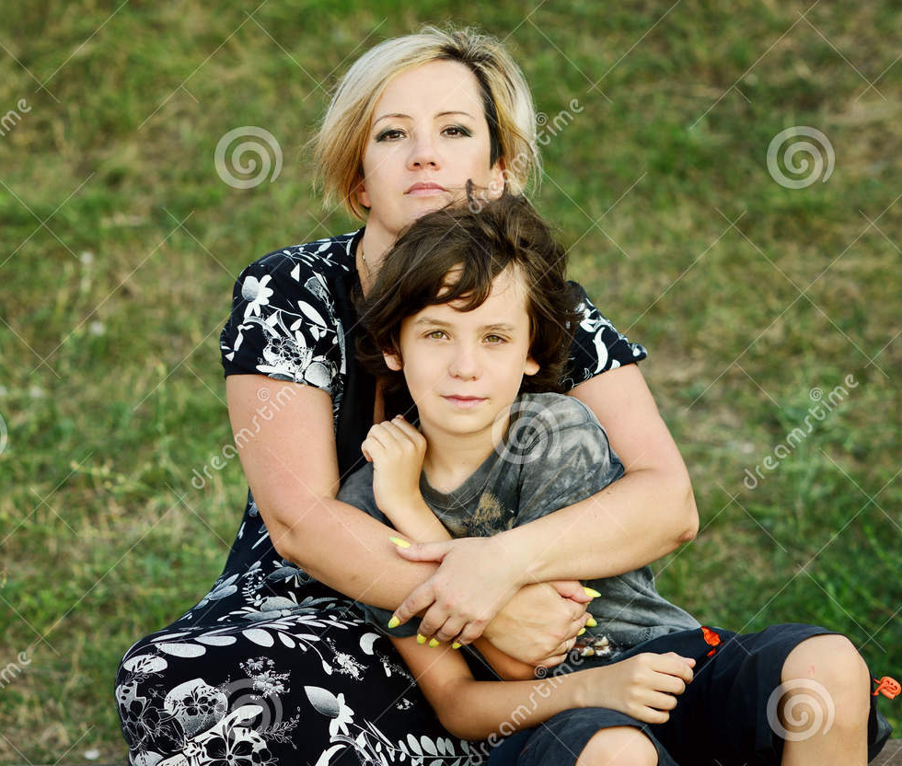
My sister’s son is my
nephew.

Slide 21

My sister’s daughter’s brother’s father is my
brother-in-law.

Slide 22


My father’s mother’s grandchild is
me / my siblings

Slide 23
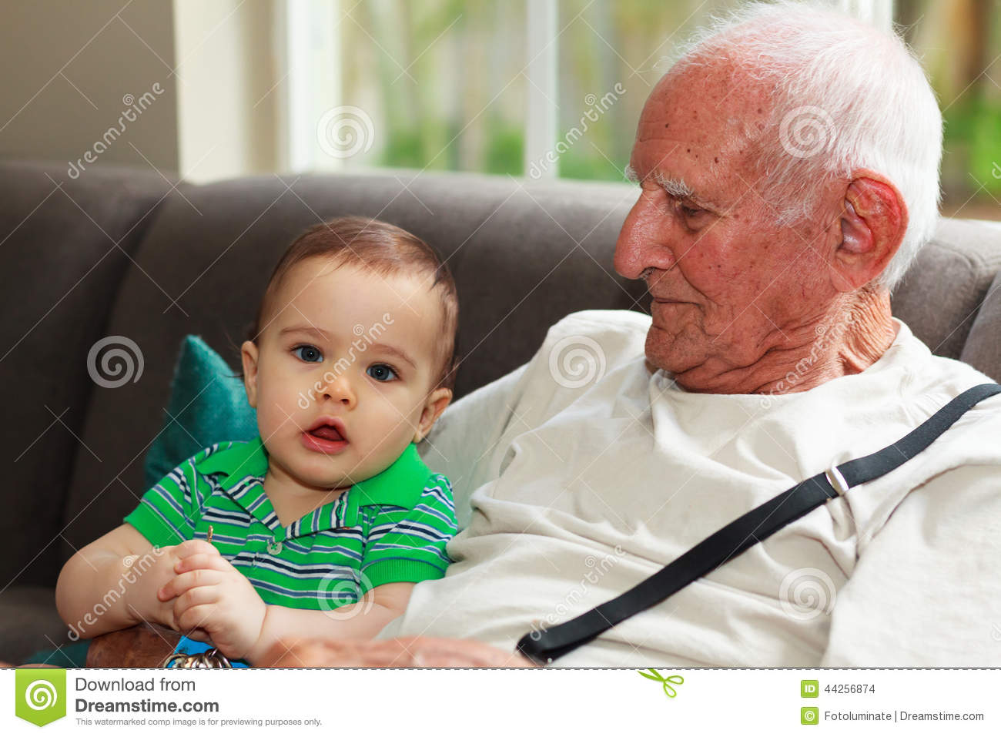
11. My grandfather’s father
is my great grandfather.

Slide 24
The End

