Slide 1
“Clean your Bedroom!”

Slide 2
Your son or daughter
has a ‘messy’ bedroom.
Tell him/her to clean it up.
Make a list of what
he/she is to do!

Slide 3
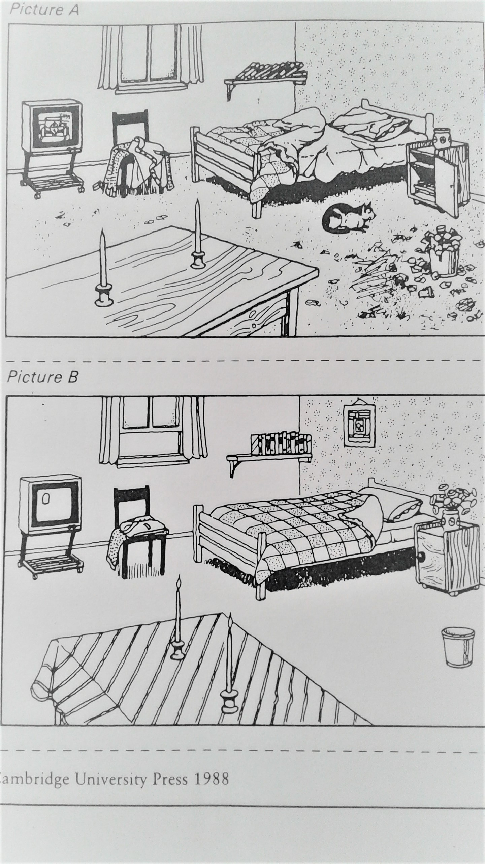

Slide 4
Tell your son/daughter to:
Turn the TV off.
Straighten the clothes on the chair.
Open the window for fresh air.
Straighten the books on the shelf.
Put a picture on the wall
Make your bed.

Slide 5
Close the door of the bedside table.
Put flowers in the flower vase.
Take the cat out of your room.
Pick up the trash/papers from the waste paper basket.
Put a table cloth on the table.
Light the candles.

Slide 6
The End

Slide 7
CREDIT: Grammar Practice Activities page 201
Cambridge University Press
Tenth printing 1992

