Slide 1
AMERICAN RIDDLES

Slide 2

How many books can you put into an empty school bag?

Slide 3
How many books can you put into an empty school bag?
ONE: AFTER THAT
IT IS NOT EMPTY

Slide 4

2. In America, on what side of a school do
oak trees grow?

Slide 5
2. In America, on what side of a school do
oak trees grow?
OUTSIDE

Slide 6
3. Which is correct? “Nine and five are thirteen.” or “Nine and five is thirteen.”

Slide 7
3. Which is correct? “Nine and five are thirteen.” or “Nine and five is thirteen.”
NEITHER: 5 + 9 = 14

Slide 8
What is black and white and read all over?

Slide 9

What is black and white and read all over?
A NEWSPAPER

Slide 10
5. With which hand should you stir soup?

Slide 11

5. With which hand should you stir soup?
NEITHER: YOU SHOULD
USE A SPOON

Slide 12
What can you hold in your right hand
but not in your left hand?

Slide 13
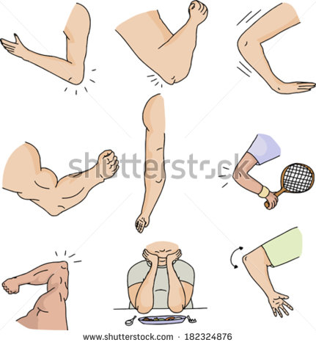
What can you hold in your right hand
but not in your left hand?
YOUR LEFT ELBOW

Slide 14
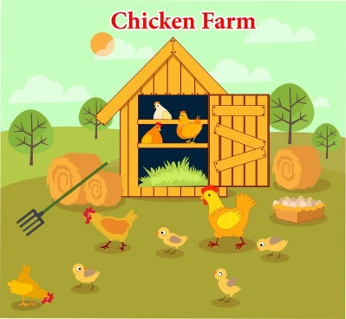
7. If a rooster laid an egg on top of a pointed hen house which side would the egg roll off?

Slide 15

7. If a rooster laid an egg on top of a pointed hen house which side would the egg roll off?
NEITHER: ROOSTERS
DON’T LAY EGGS.

Slide 16
THE END

