Slide 1
Who has the answer?

Slide 2
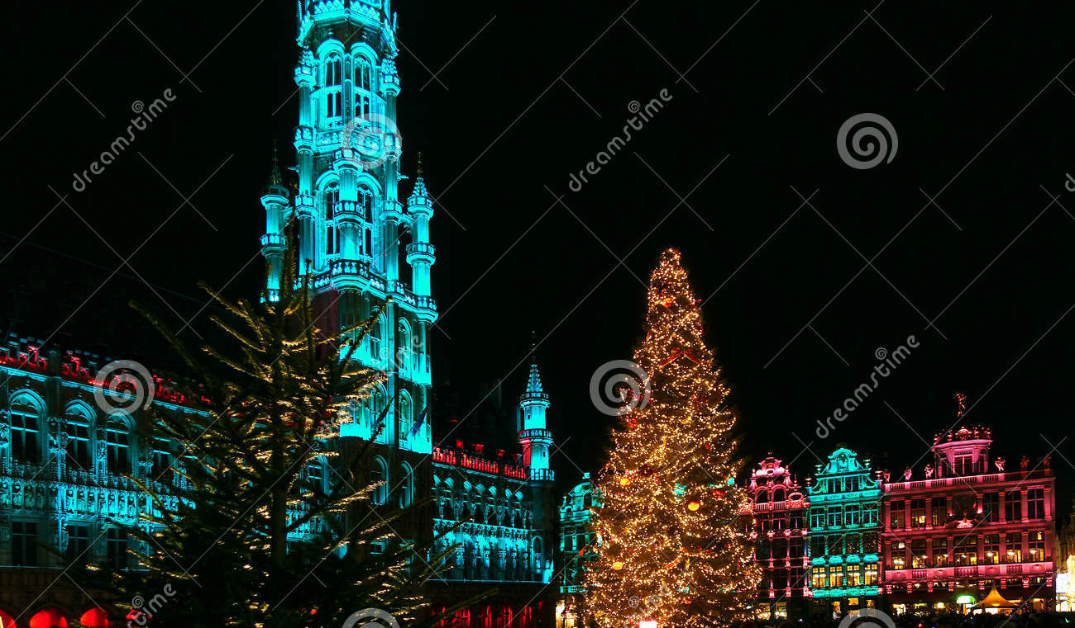
Who has the answer?
What are the 3 official languages in Belgium?

Slide 3
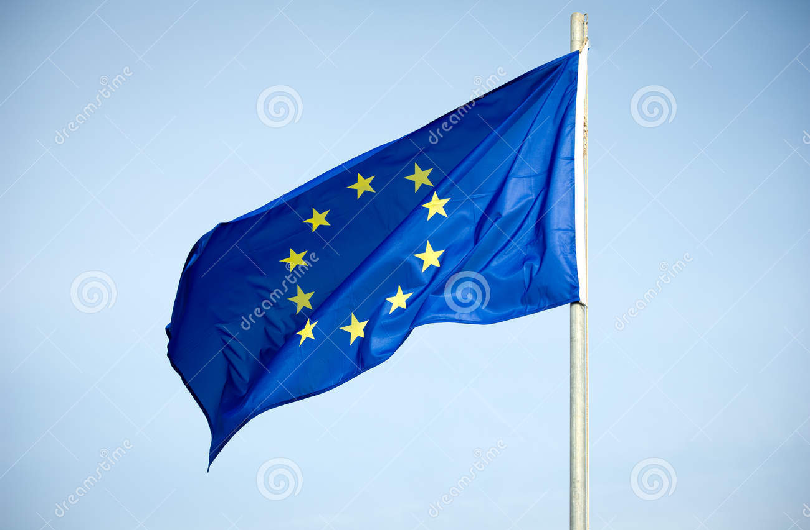
Who has the answer?
What are the 3 official languages in Belgium?
What is the currency in the European Union?

Slide 4
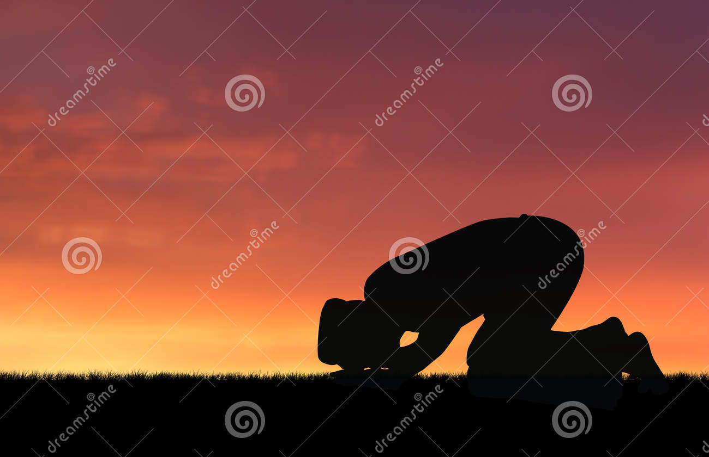
Who has the answer?
What are the 3 official languages in Belgium?
What is the currency in the European Union?
3. Who was the founder of Islam?

Slide 5
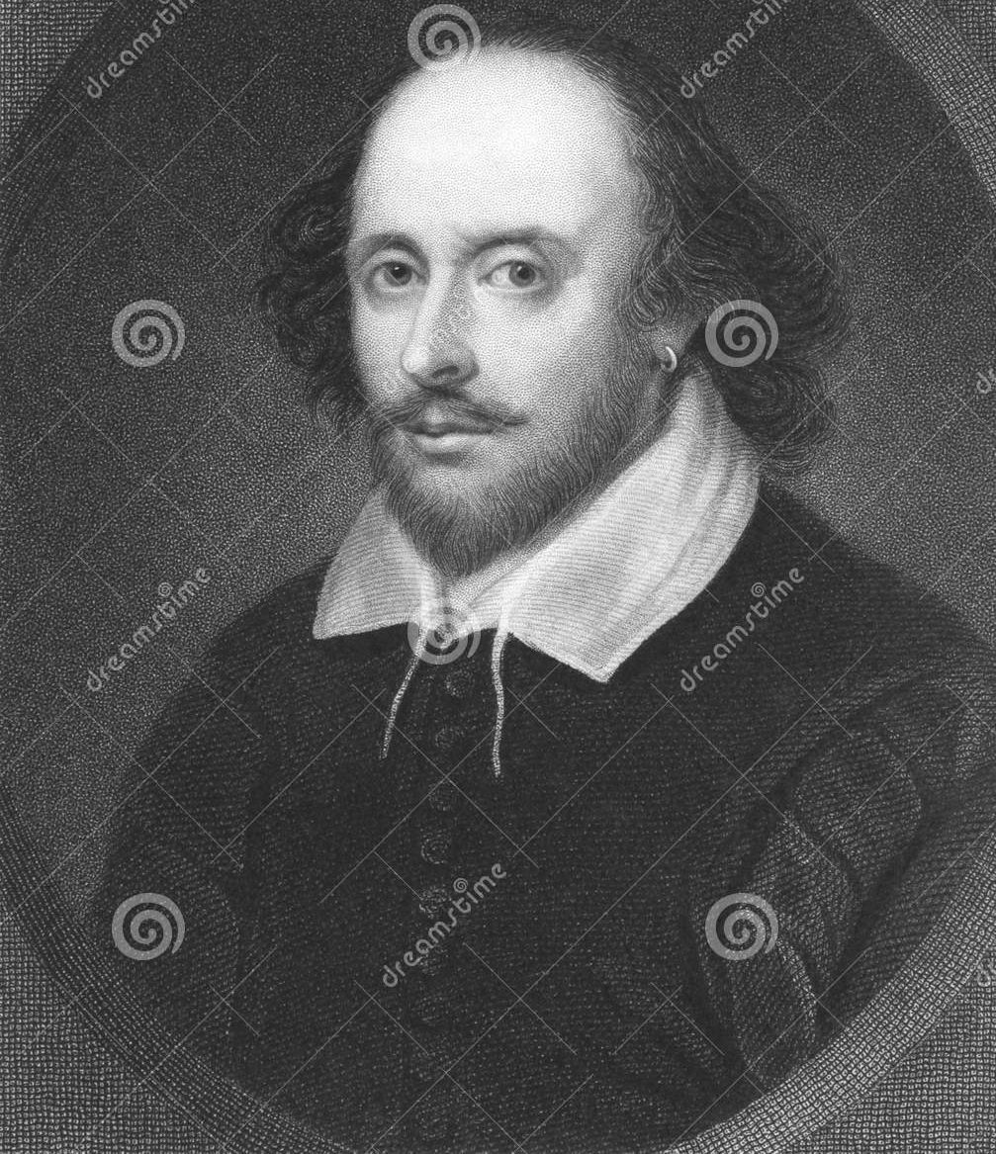
Who has the answer?
What are the 3 official languages in Belgium?
What is the currency in the European Union?
3. Who was the founder of Islam?
4. Where did William Shakespeare live?

Slide 6
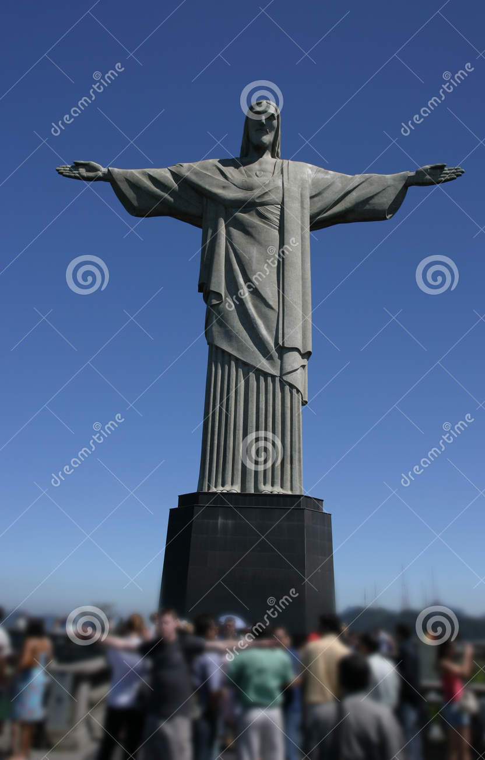
Who has the answer?
What are the 3 official languages in Belgium?
What is the currency in the European Union?
3. Who was the founder of Islam?
4. Where did William Shakespeare live?
5. Where is Rio de Janeiro?

Slide 7
Who has the answer?
What are the 3 official languages in Belgium?
What is the currency in the European Union?
3. Who was the founder of Islam?
4. Where did William Shakespeare live?
5. Where is Rio de Janeiro?
6. What is 15 x 5?

Slide 8
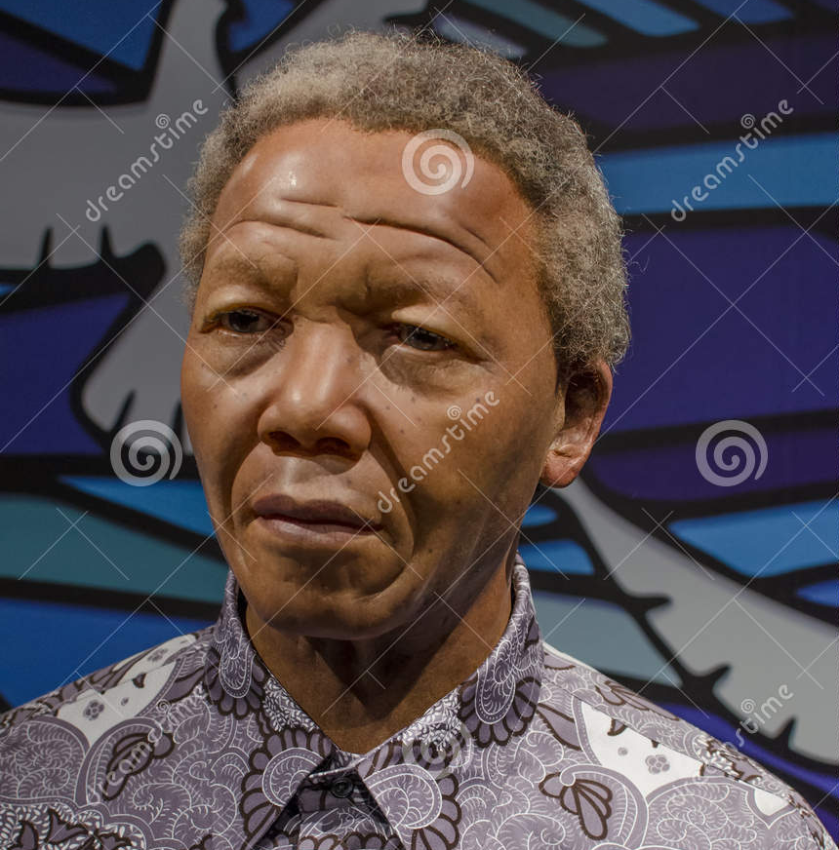
Who has the answer?
What are the 3 official languages in Belgium?
What is the currency in the European Union?
3. Who was the founder of Islam?
4. Where did William Shakespeare live?
5. Where is Rio de Janeiro?
6. What is 15 x 5?
7. Why was Nelson Mandela
imprisoned?

Slide 9
Who has the answer?
What are the 3 official languages in Belgium?
What is the currency in the European Union?
3. Who was the founder of Islam?
4. Where did William Shakespeare live?
5. Where is Rio de Janeiro?
6. What is 15 x 5?
7. Why was Nelson Mandela imprisoned?
8. When did World War II end?

Slide 10
Who has the answer?
What are the 3 official languages in Belgium?
What is the currency in the European Union?
3. Who was the founder of Islam?
4. Where did William Shakespeare live?
5. Where is Rio de Janeiro?
6. What is 15 x 5?
7. Why was Nelson Mandela imprisoned?
8. When did World War II end?
9. What is the capital city of Mongolia?

Slide 11
Who has the answer?
What are the 3 official languages in Belgium?
What is the currency in the European Union?
3. Who was the founder of Islam?
4. Where did William Shakespeare live?
5. Where is Rio de Janeiro?
6. What is 15 x 5?
7. Why was Nelson Mandela imprisoned?
8. When did World War II end?
9. What is the capital city of Mongolia?
10. Where did Mother Theresa live?

Slide 12
ANSWERS TO QUESTIONS
1 - 10

Slide 13


Who has the answer?
What are the 3 official languages in Belgium?
French, Flemish, Dutch

Slide 14

Who has the answer?
2. What is the currency in the European Union?
The Euro

Slide 15
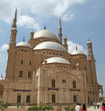
Who has the answer?
3. Who was the founder of Islam?
MOHAMMED

Slide 16
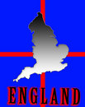
Who has the answer?
4. Where did William Shakespeare live?
IN ENGLAND

Slide 17
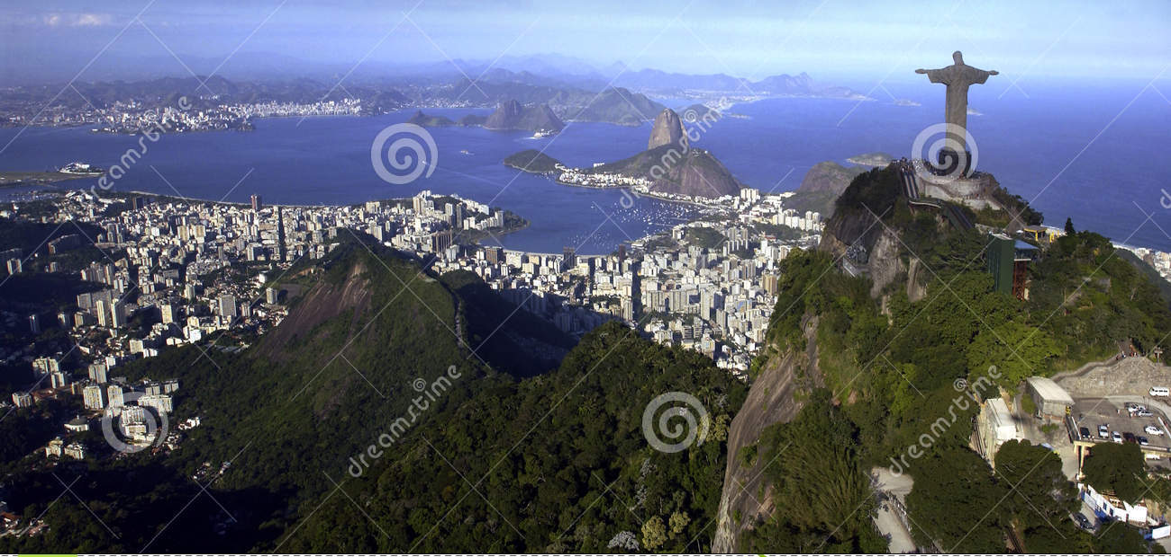
Who has the answer?
5. Where is Rio de Janeiro?
IN BRAZIL

Slide 18
Who has the answer?
6. What is 15 x 5?
75

Slide 19
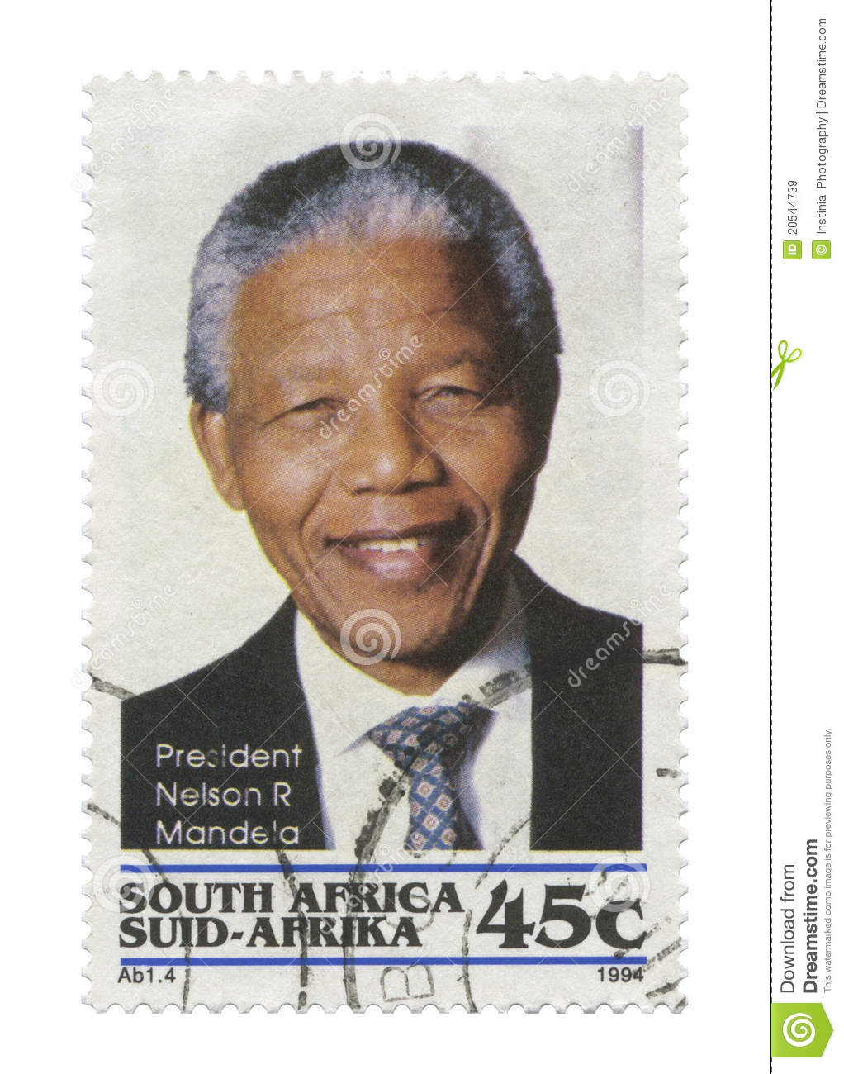
Who has the answer?
7. Why was Nelson Mandela imprisoned?
FOUGHT AGAINST APARTHEID

Slide 20
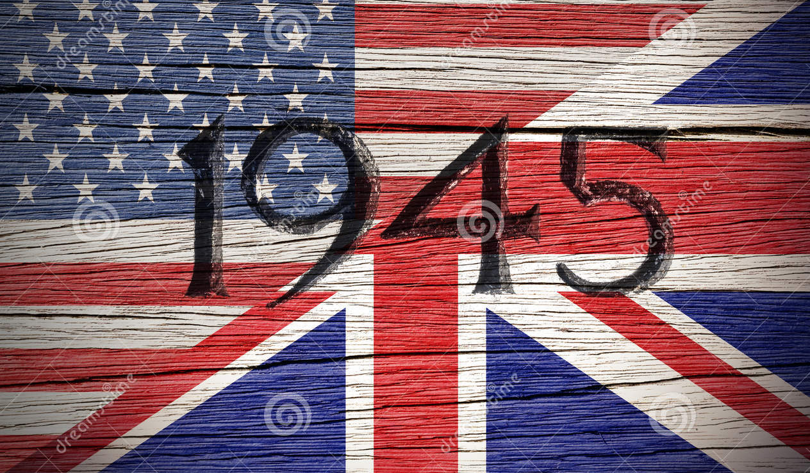
Who has the answer?
8. When did World War II end?

Slide 21
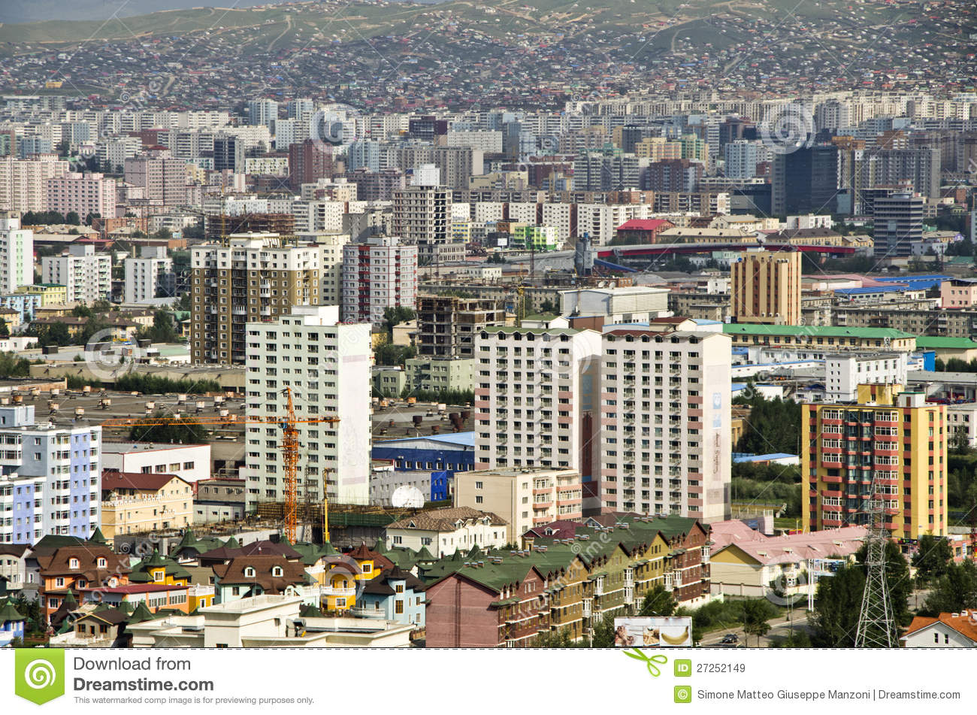
Who has the answer?
9. What is the capital city of Mongolia?
ULAANBAATAR

Slide 22
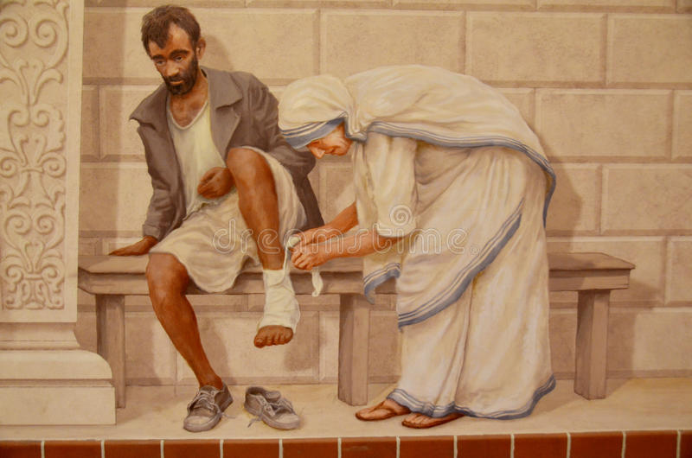
Who has the answer?
10. Where did Mother Theresa live?
IN INDIA

Slide 23
Questions # 11 - 20

Slide 24
Who has the answer?
11. At what temperature does water freeze? F/C

Slide 25
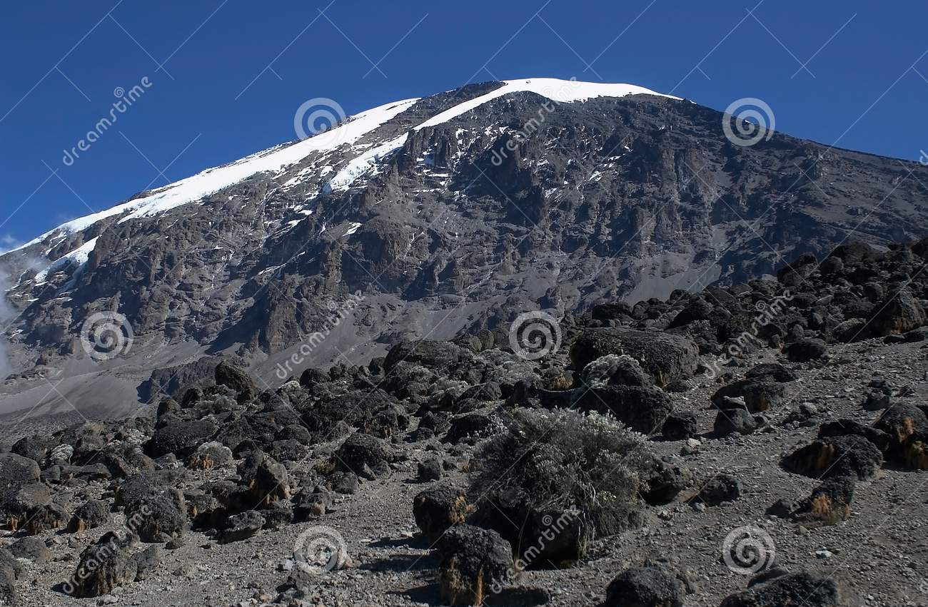
Who has the answer?
11. At what temperature does water freeze? F/C
12. What is the highest mountain in Africa?

Slide 26
Who has the answer?
11. At what temperature does water freeze? F/C
12. What is the highest mountain in Africa?
13. How many legs on a black widow spider?

Slide 27
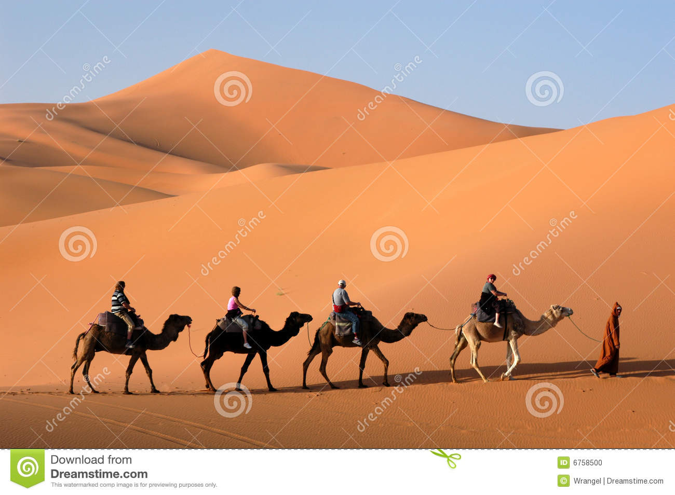
Who has the answer?
11. At what temperature does water freeze? F/C
12. What is the highest mountain in Africa?
13. How many legs on a black widow spider?
14. What is the largest desert in the world?

Slide 28
Who has the answer?
11. At what temperature does water freeze? F/C
12. What is the highest mountain in Africa?
13. How many legs on a black widow spider?
14. What is the largest desert in the world?
15. What happens in a lunar eclipse?

Slide 29
Who has the answer?
11. At what temperature does water freeze? F/C
12. What is the highest mountain in Africa?
13. How many legs on a black widow spider?
14. What is the largest desert in the world?
15. What happens in a lunar eclipse?
16. How many meters are in a kilometer?

Slide 30
Who has the answer?
11. At what temperature does water freeze? F/C
12. What is the highest mountain in Africa?
13. How many legs on a black widow spider?
14. What is the largest desert in the world?
15. What happens in a lunar eclipse?
16. How many meters are in a kilometer?
17. Who is the longest reigning monarch in the
world?

Slide 31
Who has the answer?
11. At what temperature does water freeze? F/C
12. What is the highest mountain in Africa?
13. How many legs on a black widow spider?
14. What is the largest desert in the world?
15. What happens in a lunar eclipse?
16. How many meters are in a kilometer?
17. Who is the longest reigning monarch in the
world?
18. What is 72 divided by 12?

Slide 32
Who has the answer?
11. At what temperature does water freeze? F/C
12. What is the highest mountain in Africa?
13. How many legs on a black widow spider?
14. What is the largest desert in the world?
15. What happens in a lunar eclipse?
16. How many meters are in a kilometer?
17. Who is the longest reigning monarch in the
world?
18. What is 72 divided by 12?
19. What is cheese made from?

Slide 33
Who has the answer?
11. At what temperature does water freeze? F/C
12. What is the highest mountain in Africa?
13. How many legs on a black widow spider?
14. What is the largest desert in the world?
15. What happens in a lunar eclipse?
16. How many meters are in a kilometer?
17. Who is the longest reigning monarch in the
world?
18. What is 72 divided by 12?
19. What is cheese made from?
20. Italian cuisine…cuisine is from what language
and what does it mean?

Slide 34
ANSWERS TO QUESTIONS
11 -20

Slide 35
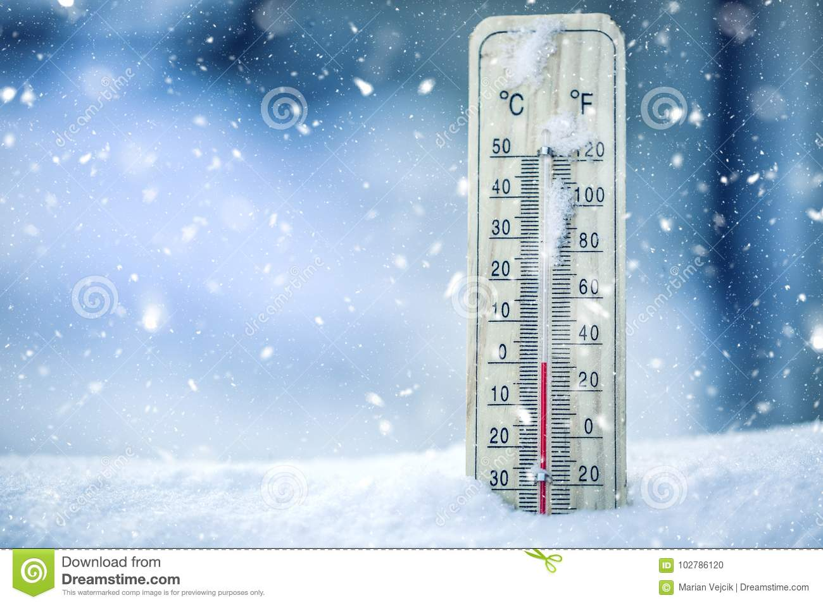
Who has the answer?
11. At what temperature does water freeze? F/C
0 degrees Celsius
32 degrees Farhenheit

Slide 36
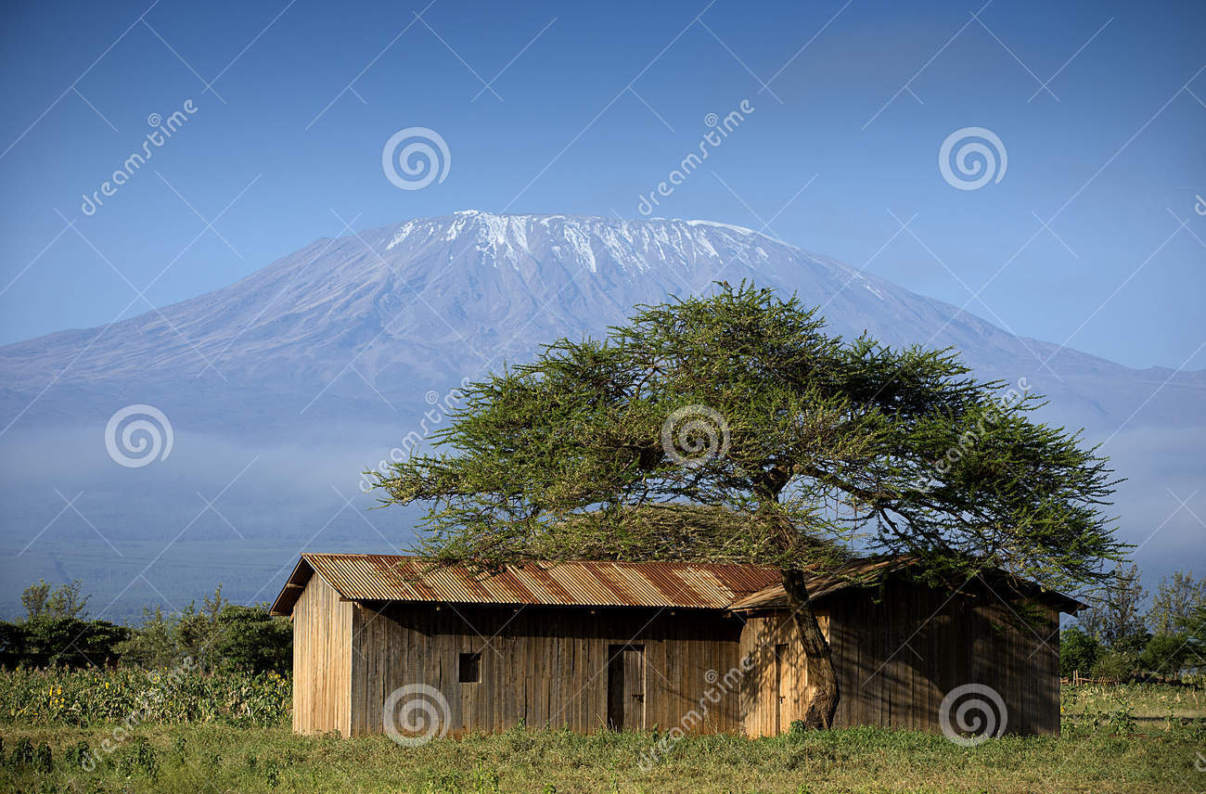
Who has the answer?
12. What is the highest mountain in Africa?
Mount Kilimanjaro

Slide 37
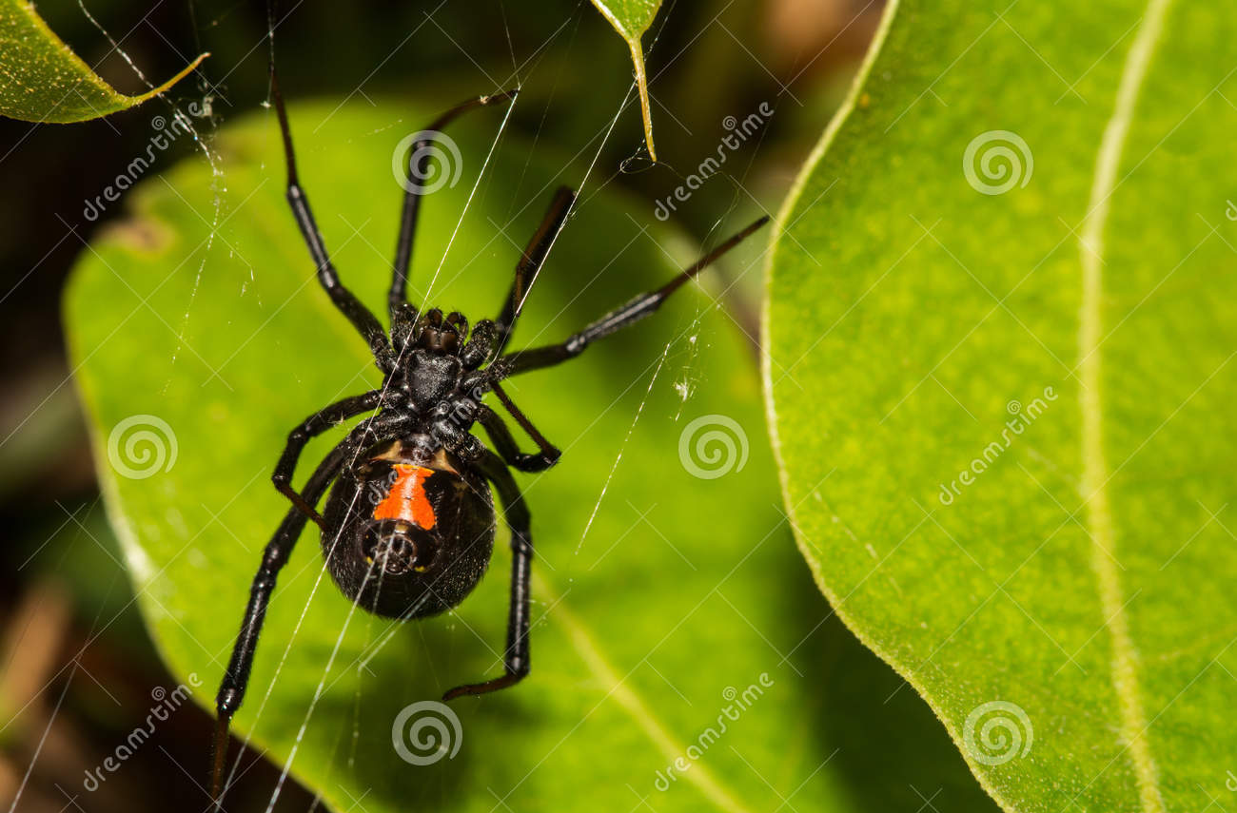
Who has the answer?
13. How many legs on a black widow spider?
Eight Legs

Slide 38
Who has the answer?
14. What is the largest desert in the world?
Sahara hot desert at 3.5million square miles (9 million square kilometers), but Antarctica, a polar desert covering 5 million square miles (13 million square kilometers), is the largest desert overall.
** DESERT is defined as an land having less than 10 inches of rain a year.

Slide 39
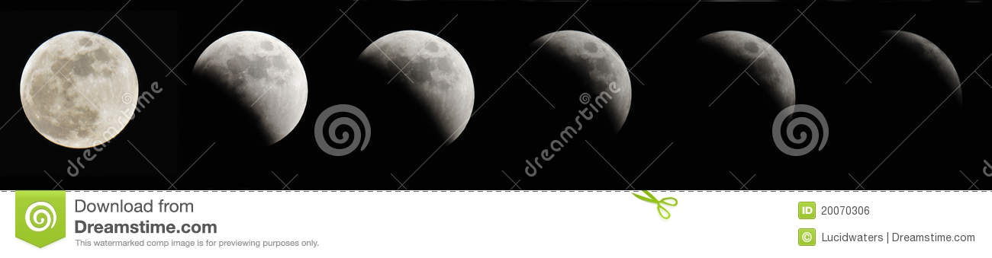
Who has the answer?
15. What happens in a lunar eclipse?
The Moon Appears Darkened in the
Earth’s shadow

Slide 40
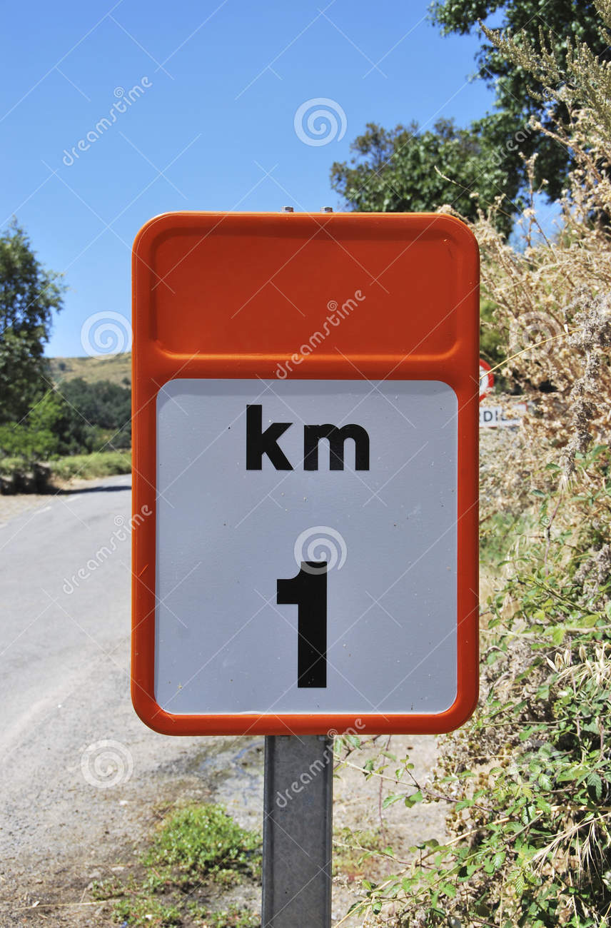
Who has the answer?
16. How many meters are in a kilometer?
1000 METERS

Slide 41
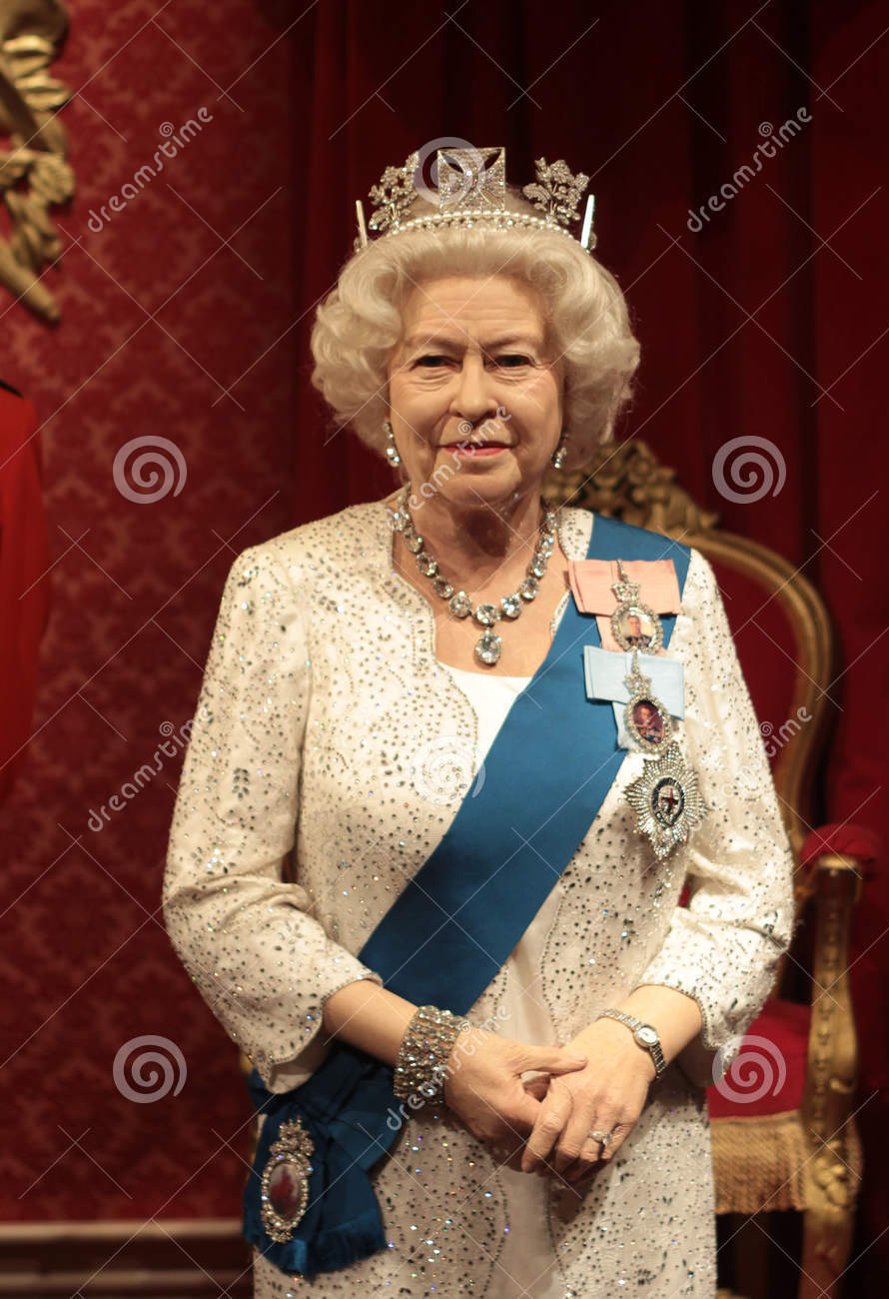
Who has the answer?
17. Who is the longest reigning monarch in the
world?
QUEEN ELIZABETH
OF GREAT BRITIAN
Coronation June 1953
(64 years)

Slide 42
Who has the answer?
18. What is 72 divided by 12?
6

Slide 43
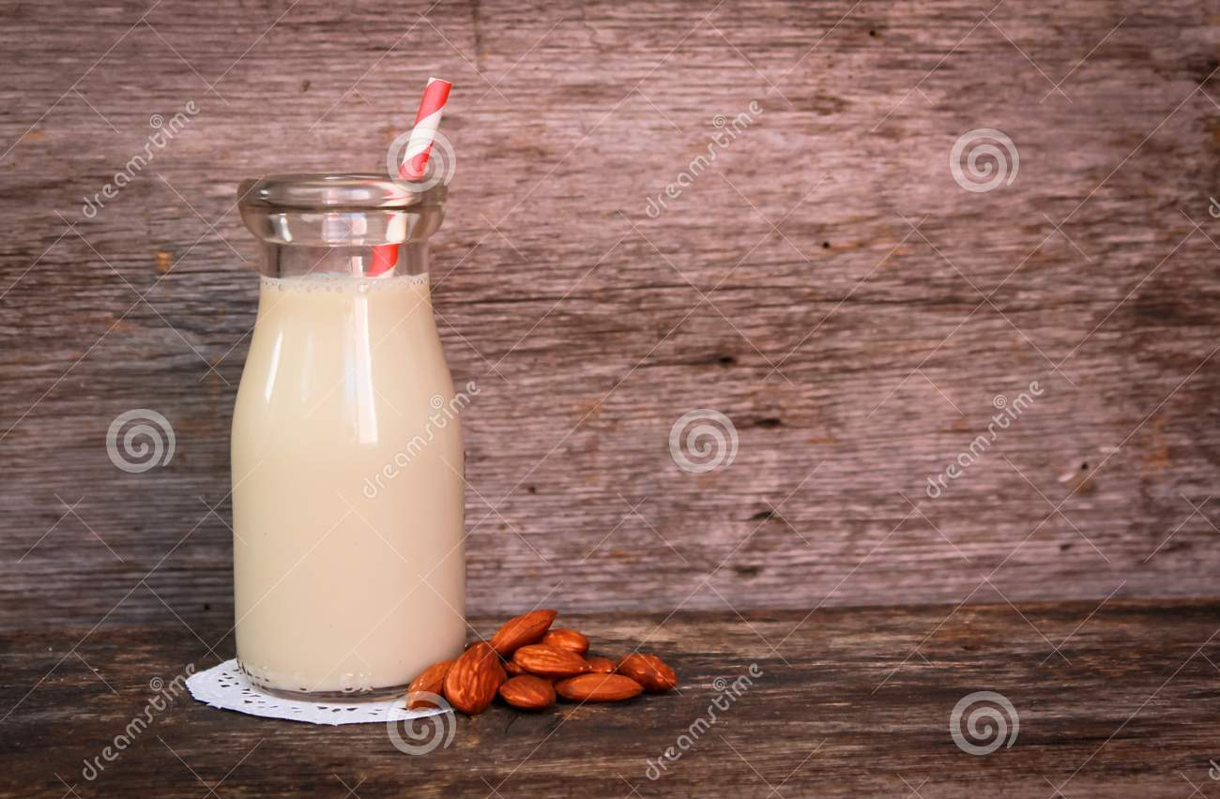
Who has the answer?
19. What is cheese made from?
MILK

Slide 44
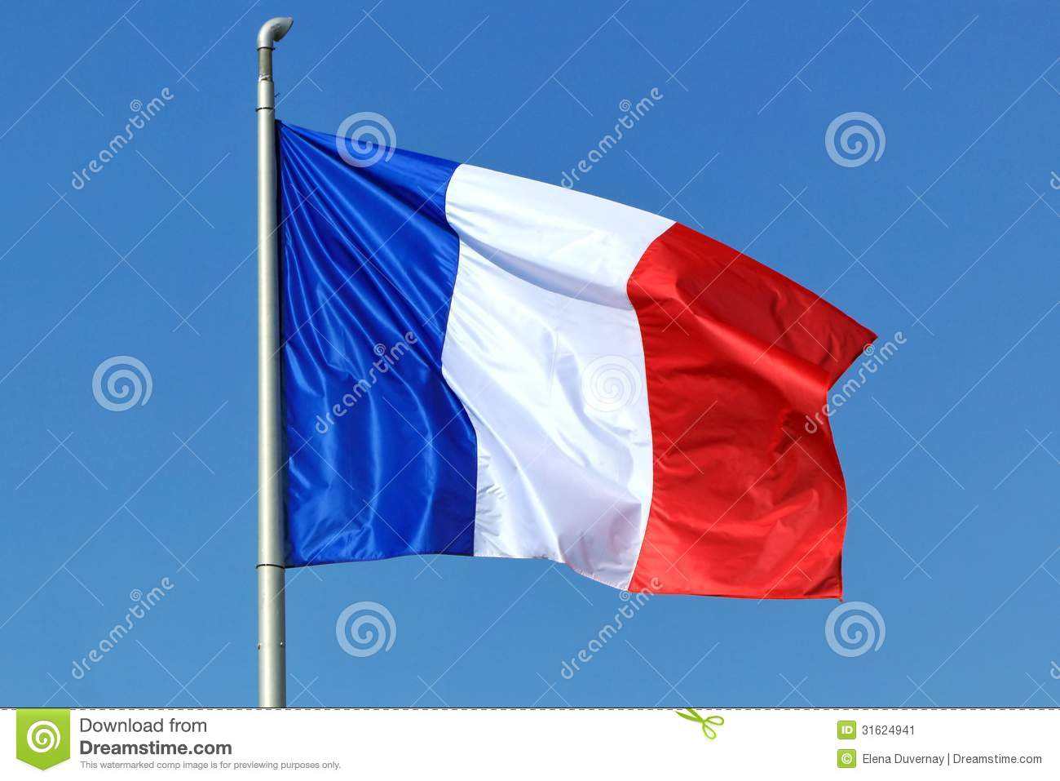
Who has the answer?
20. Italian cuisine..’cuisine’ is from what language
‘CUISINE’ IN FRENCH
MEANS ‘KITCHEN’

Slide 45
THE END

